Slide 1
American Muslim Poll 2019: Predicting & Preventing Islamophobia
May 1, 2019
NYU Washington, DC

Slide 2
Welcome!

Slide 3
Join the conversation using #ISPUPoll
Poll resources: ispu.org/poll | Twitter: @TheISPU /
Instagram: @The_ISPU | Facebook: /TheISPU

Slide 4
Overview
Methodology
Key Findings
Panel Discussion, Q&A

Slide 5
Why This Poll?
Triumphs
Historical class of freshman lawmakers elected
Tribulations
Travel ban
Government shutdown
#MeToo

Slide 6
Methodology
Dr. David Dutwin, Chief Methodologist
Nationally representative sample of:
Muslims (818)
Jews (393)
Protestants (281)
White Evangelicals (184)
Catholics (233)
Non-Affiliated (353)
N = 2,376
All given identical surveys
Survey fielded January 8–25, 2019
Detailed discussion of methodology available www.ispu.org/poll

Slide 7
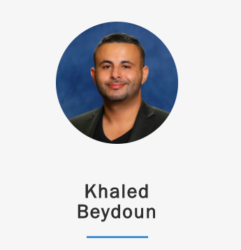
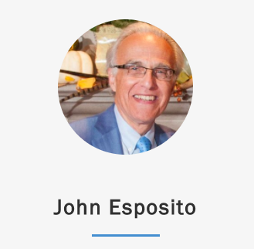
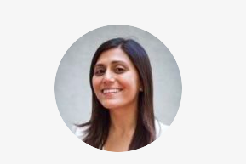
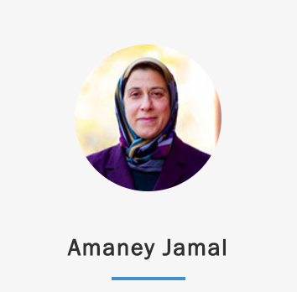
Advisors

Slide 8
Advisors
Khaled Beydoun
Karam Dana
David Dutwin
John Esposito
Rachel M. Gillum
Amaney Jamal
Nazita Lajevardi
Kameelah Mu’min Rashad

Slide 9
Key Findings
Civic Engagement
Muslims are the least likely faith or non-faith group we measured to approve of President Trump
Support for Muslim Ban does little to help candidates with most voters
Though growing, Muslim voter registration and engagement still lags behind other groups
Income, age, mosque attendance, and local political engagement predict voter participation among Muslims

Slide 10
Key Findings
Islamophobia Index
Islamophobia Index inches up
Knowing a Muslim, knowledge of Islam and positive views of other minorities is linked to lower Islamophobia
Jews and Hispanic Americans are most favorable toward Muslims, and white Evangelicals least

Slide 11
Other Topics Covered by 2019 Poll
You can read more about the following topics in our report:
Sectarian, Gender Discrimination
Rate of Sexual Assault and Reporting
Public and Private Religi0us Engagement
Topics To Be Released At a Later Time:
Mental health and suicidality
Religious literacy

Slide 12
Civic Engagement

Slide 13
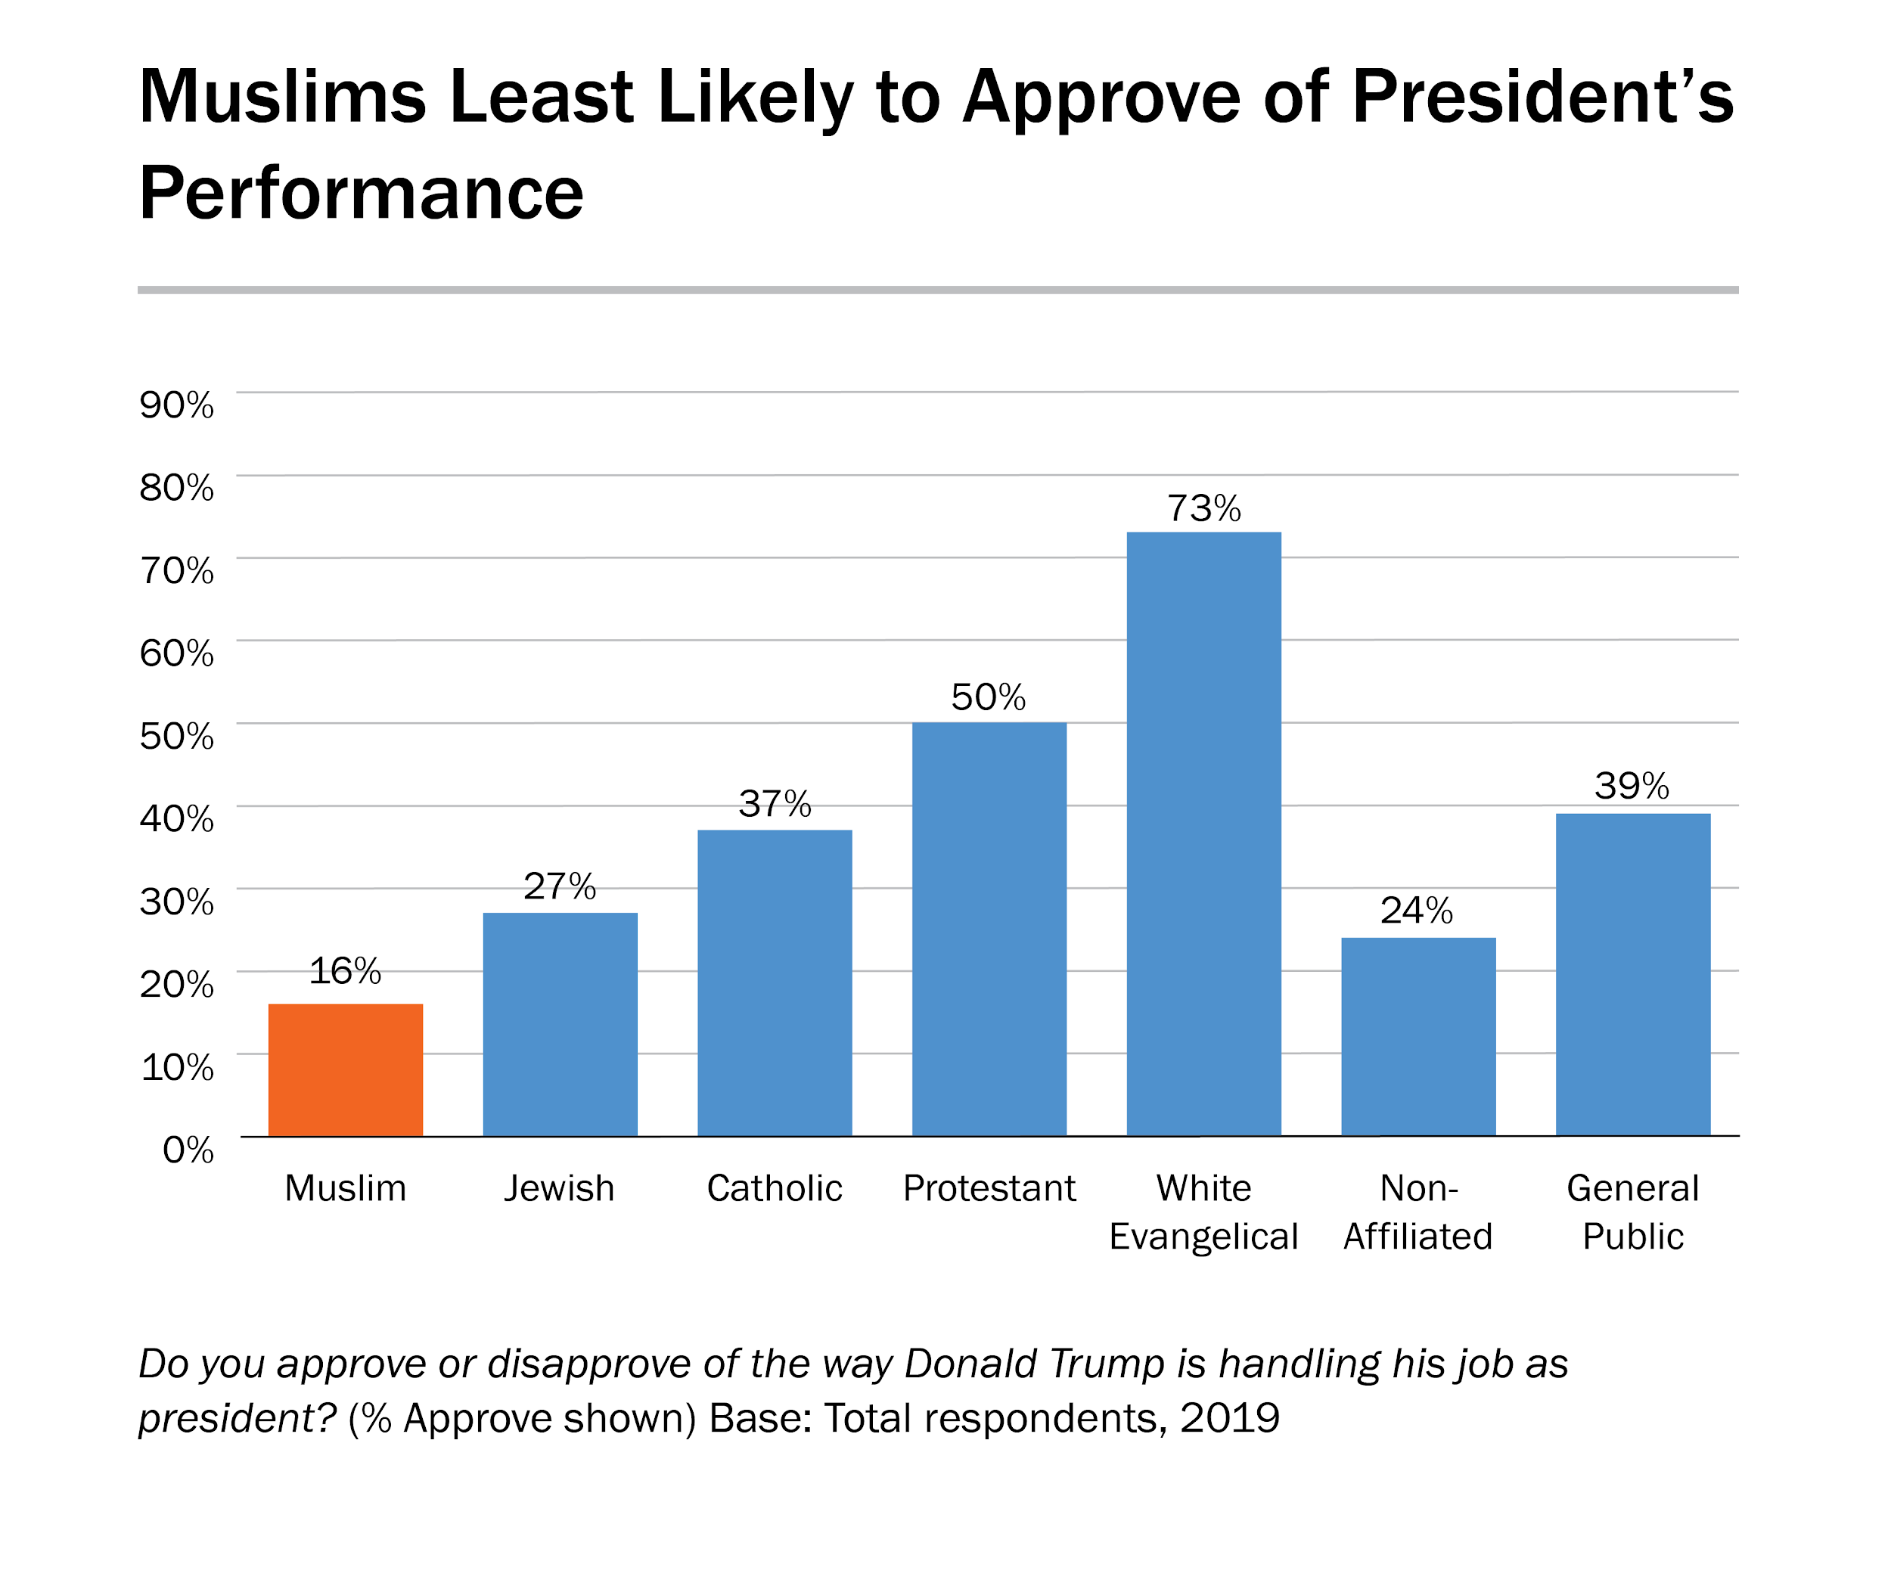

Slide 14
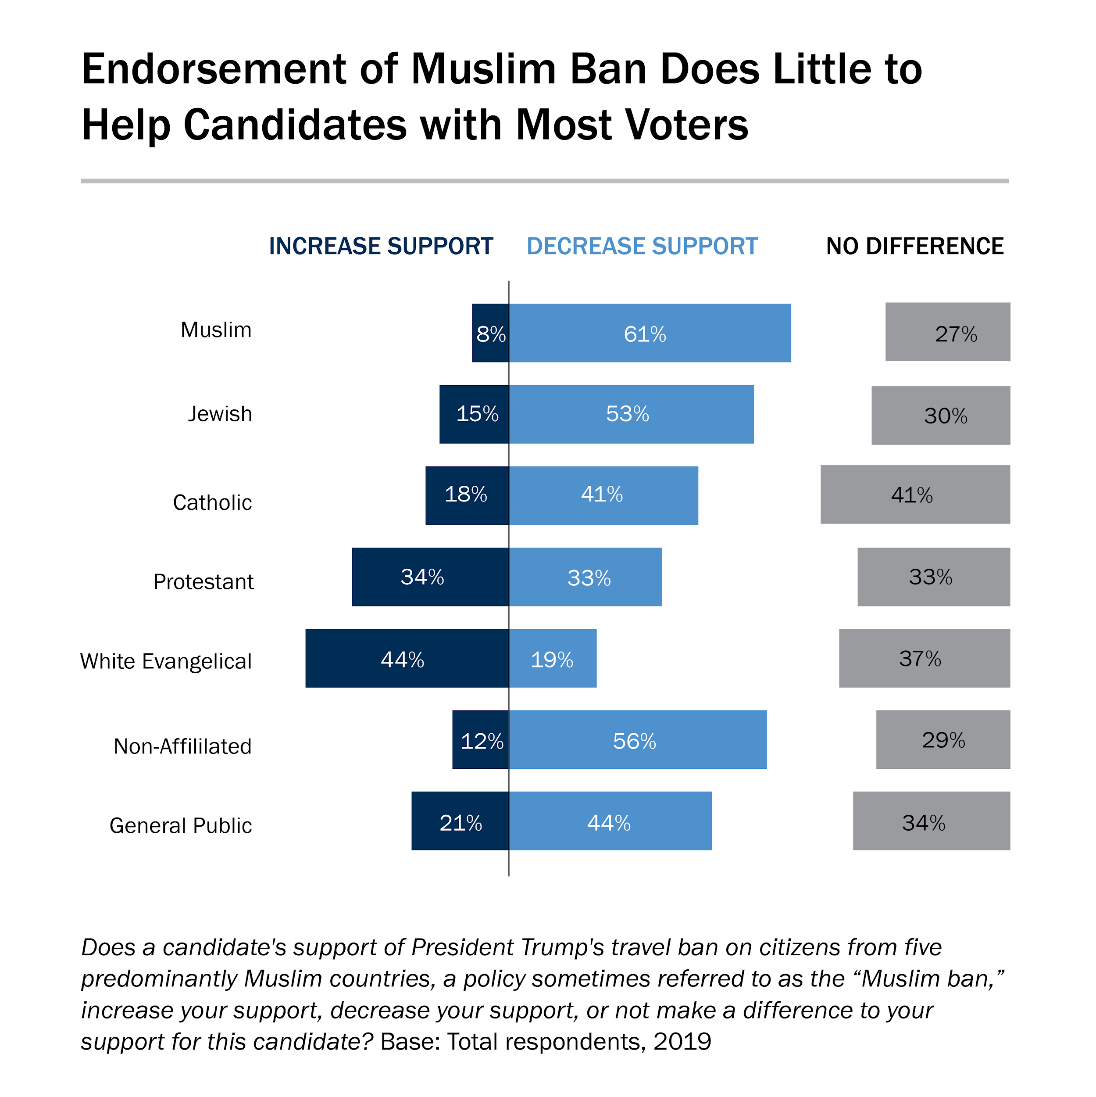

Slide 15
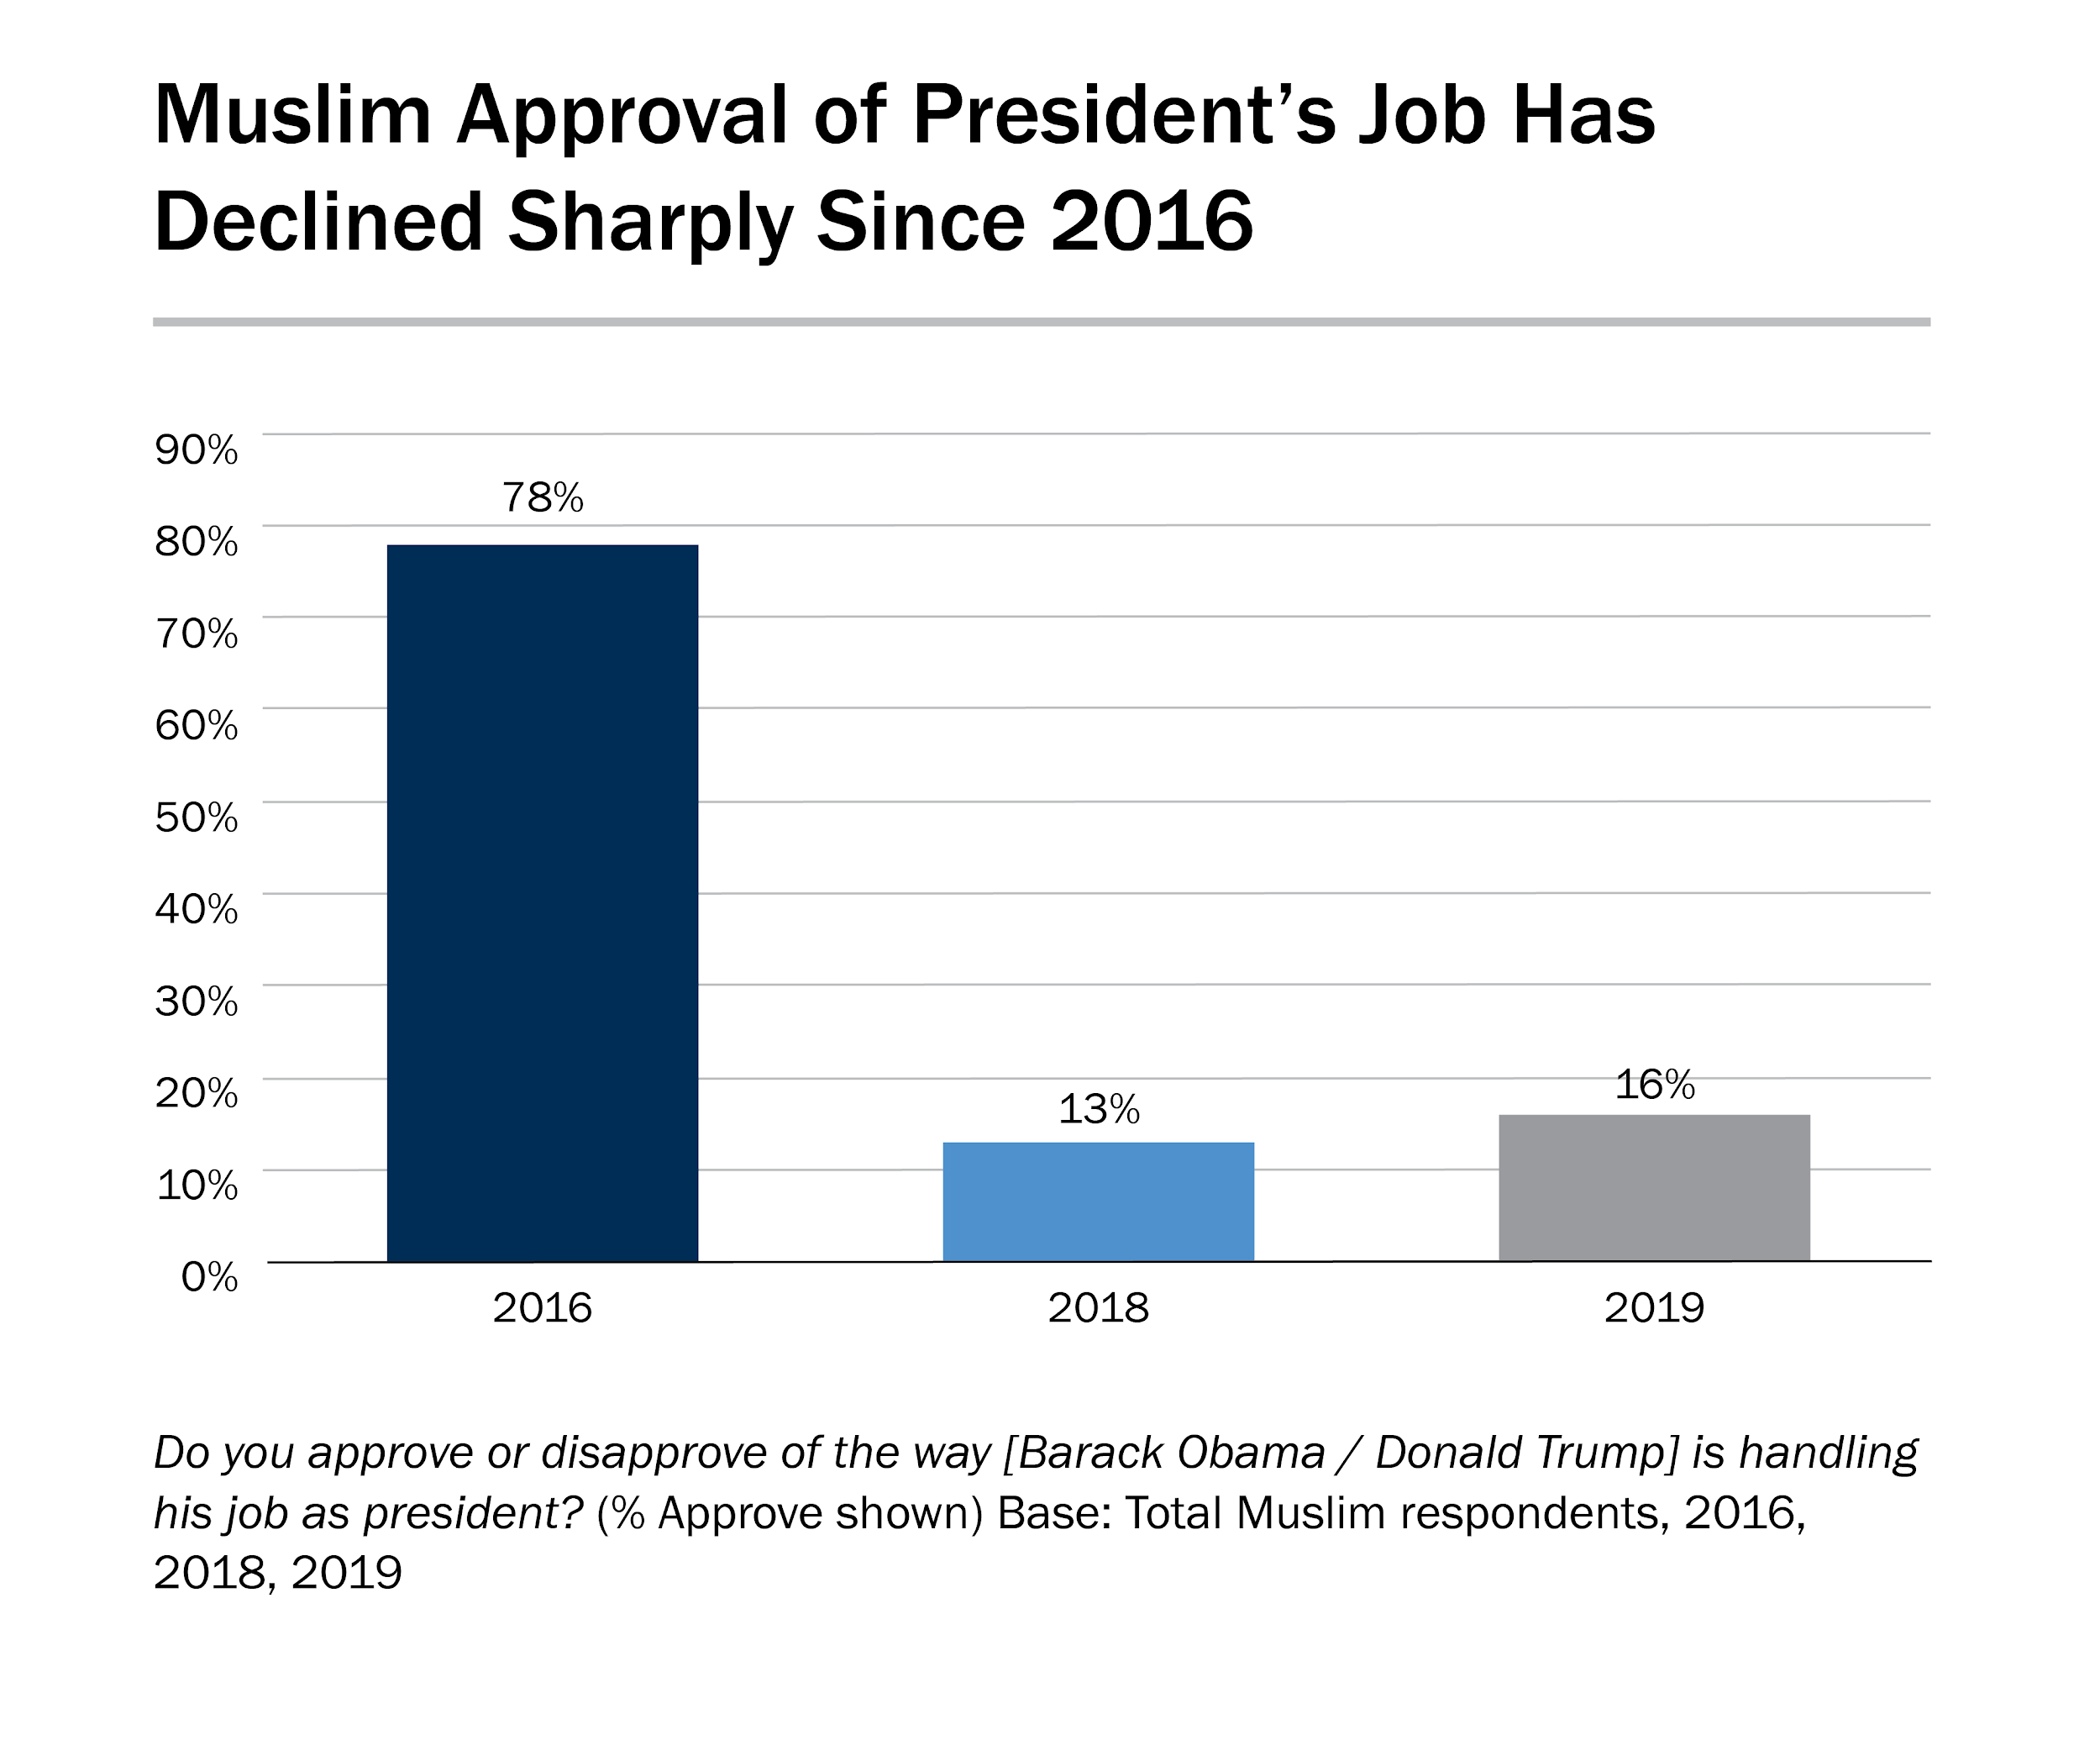

Slide 16
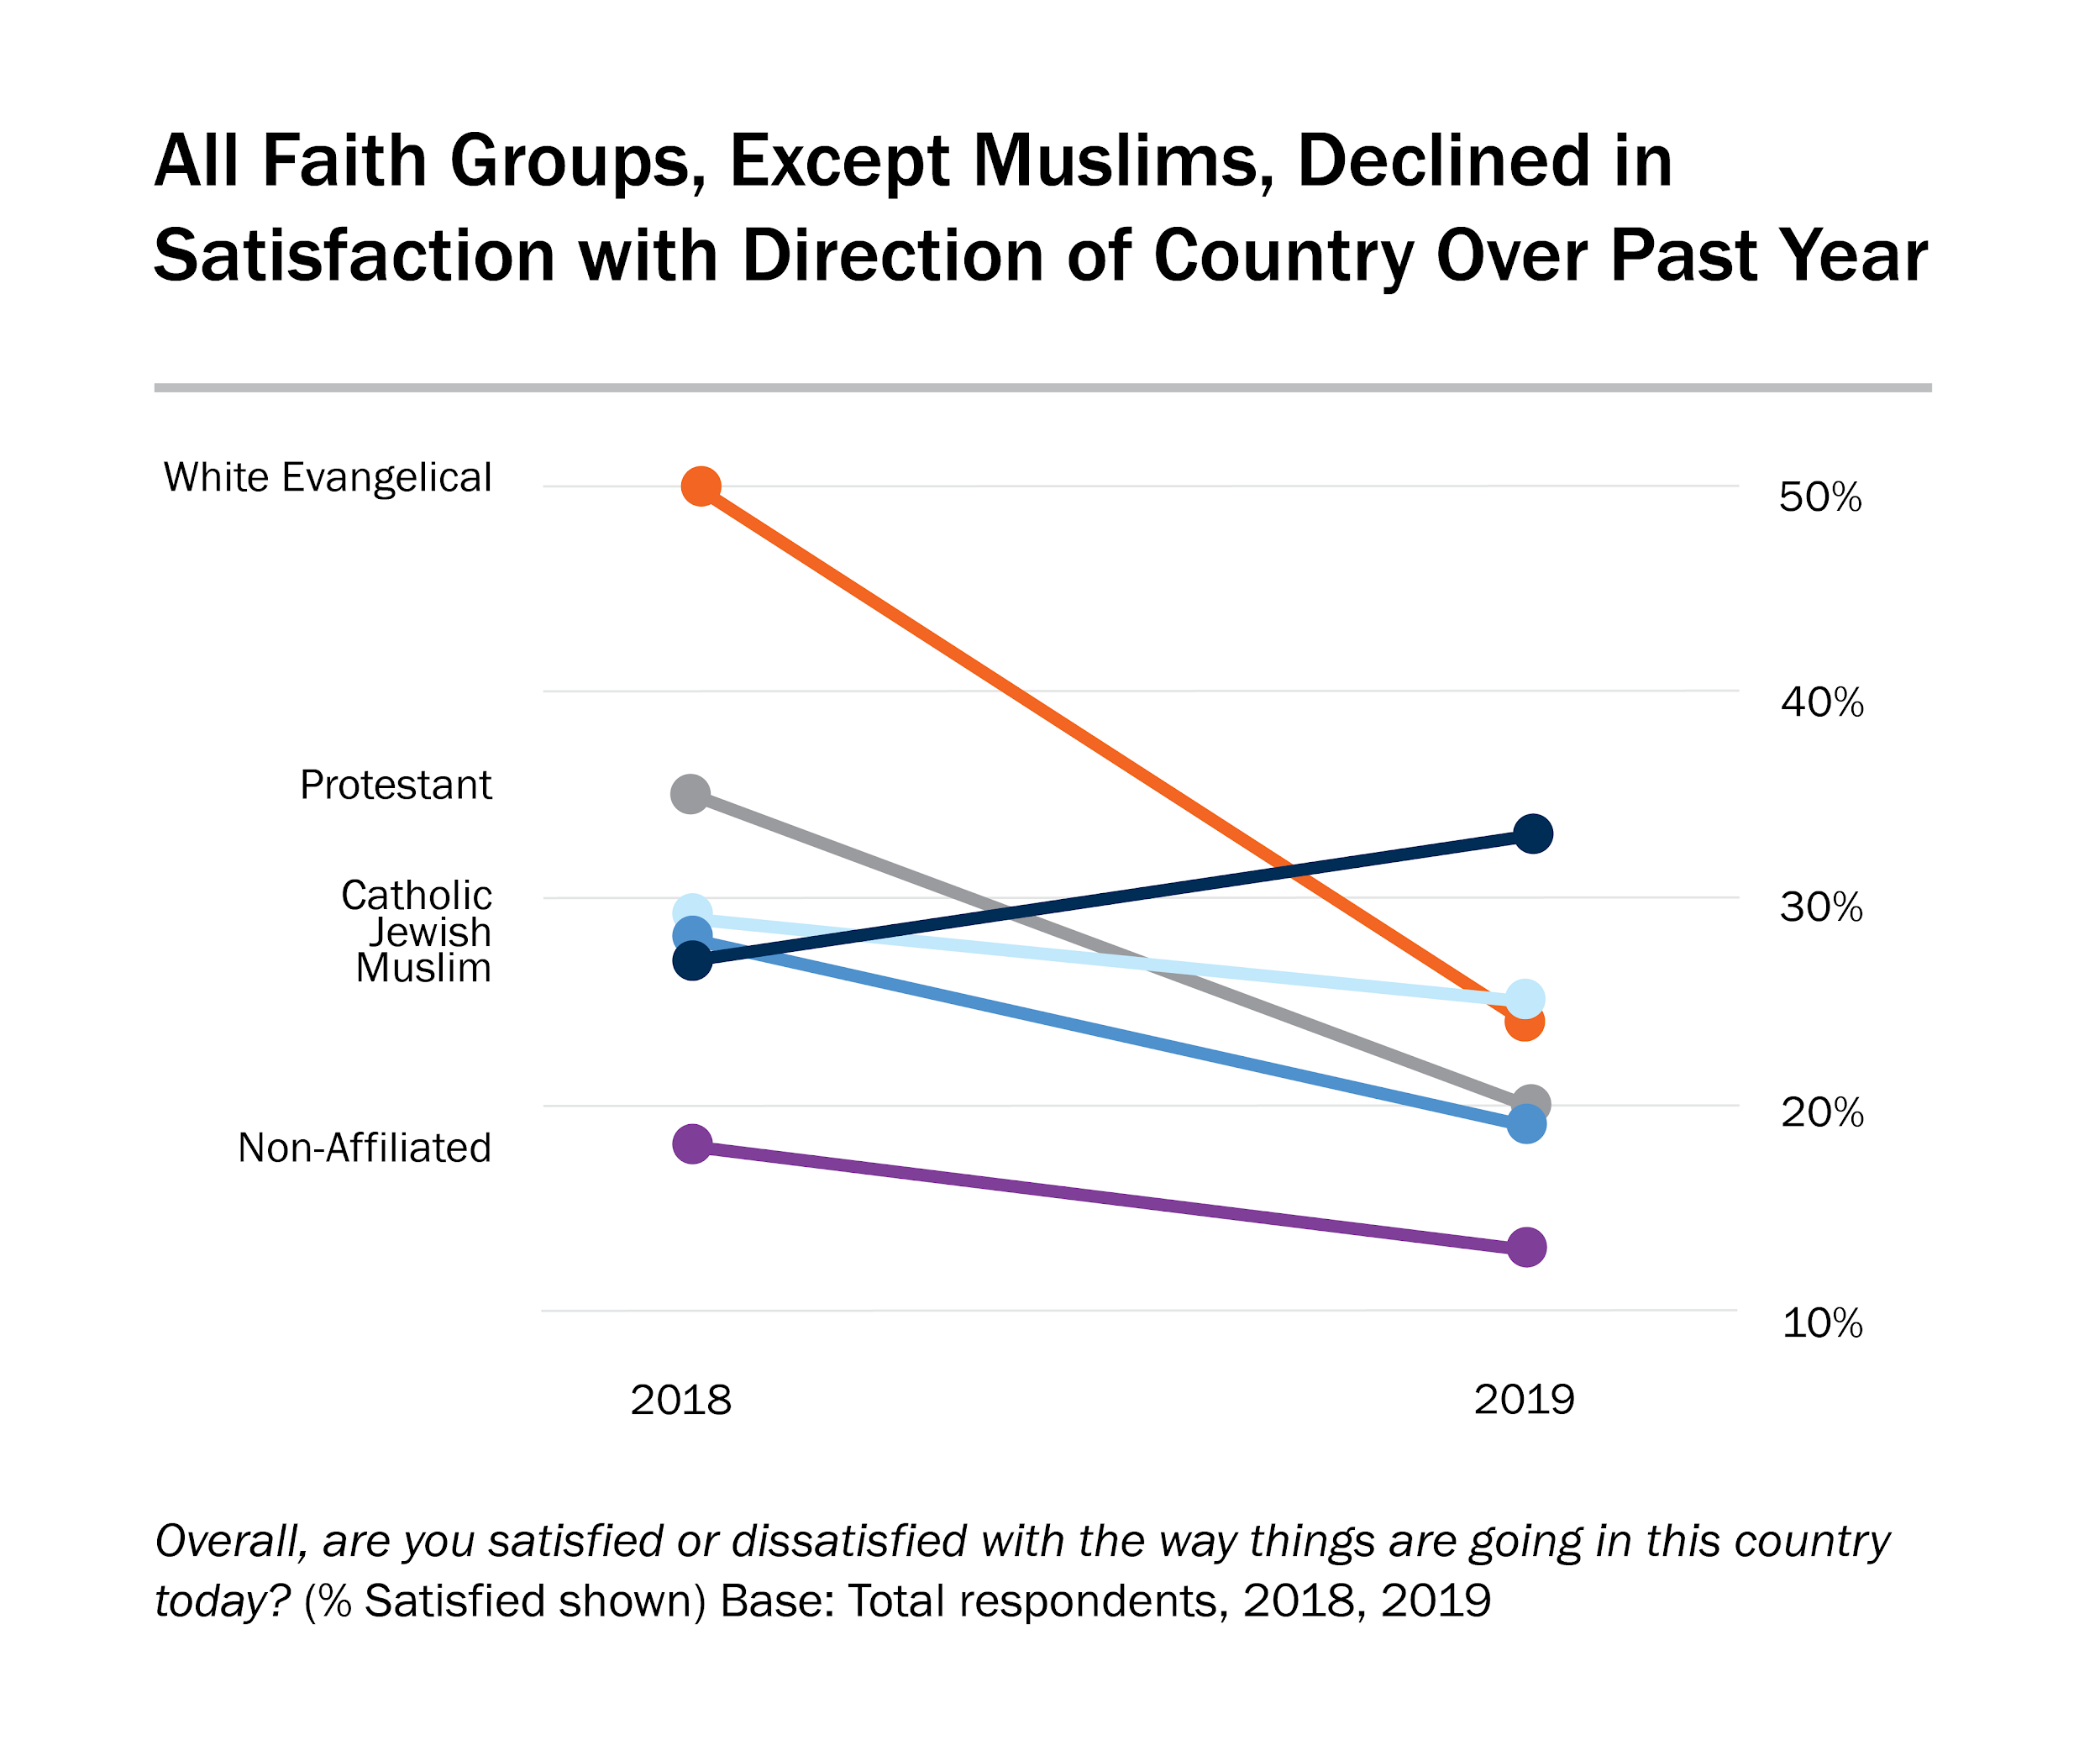

Slide 17
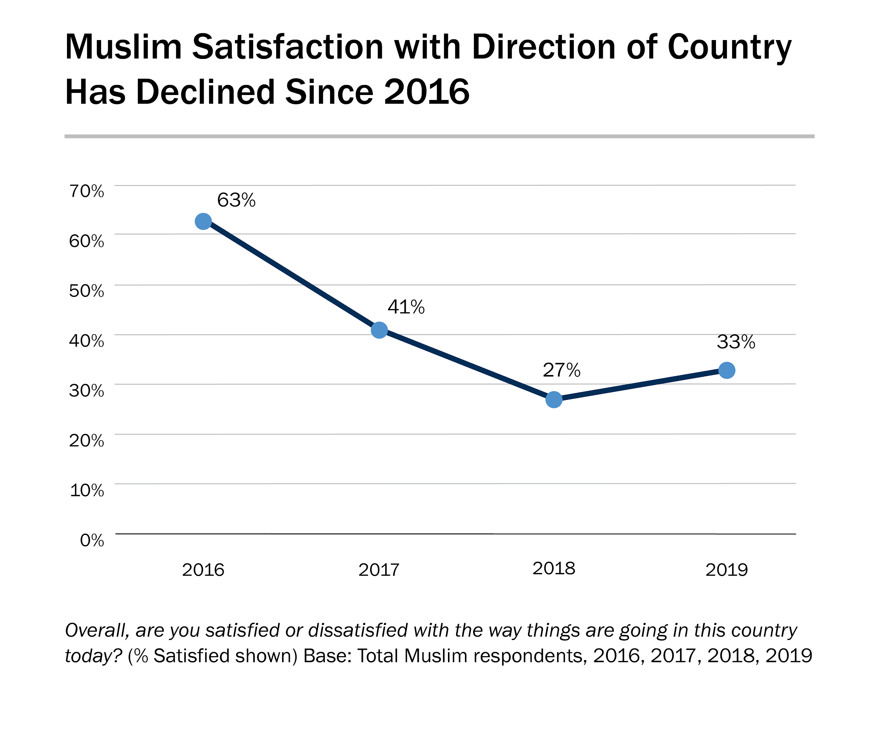

Slide 18
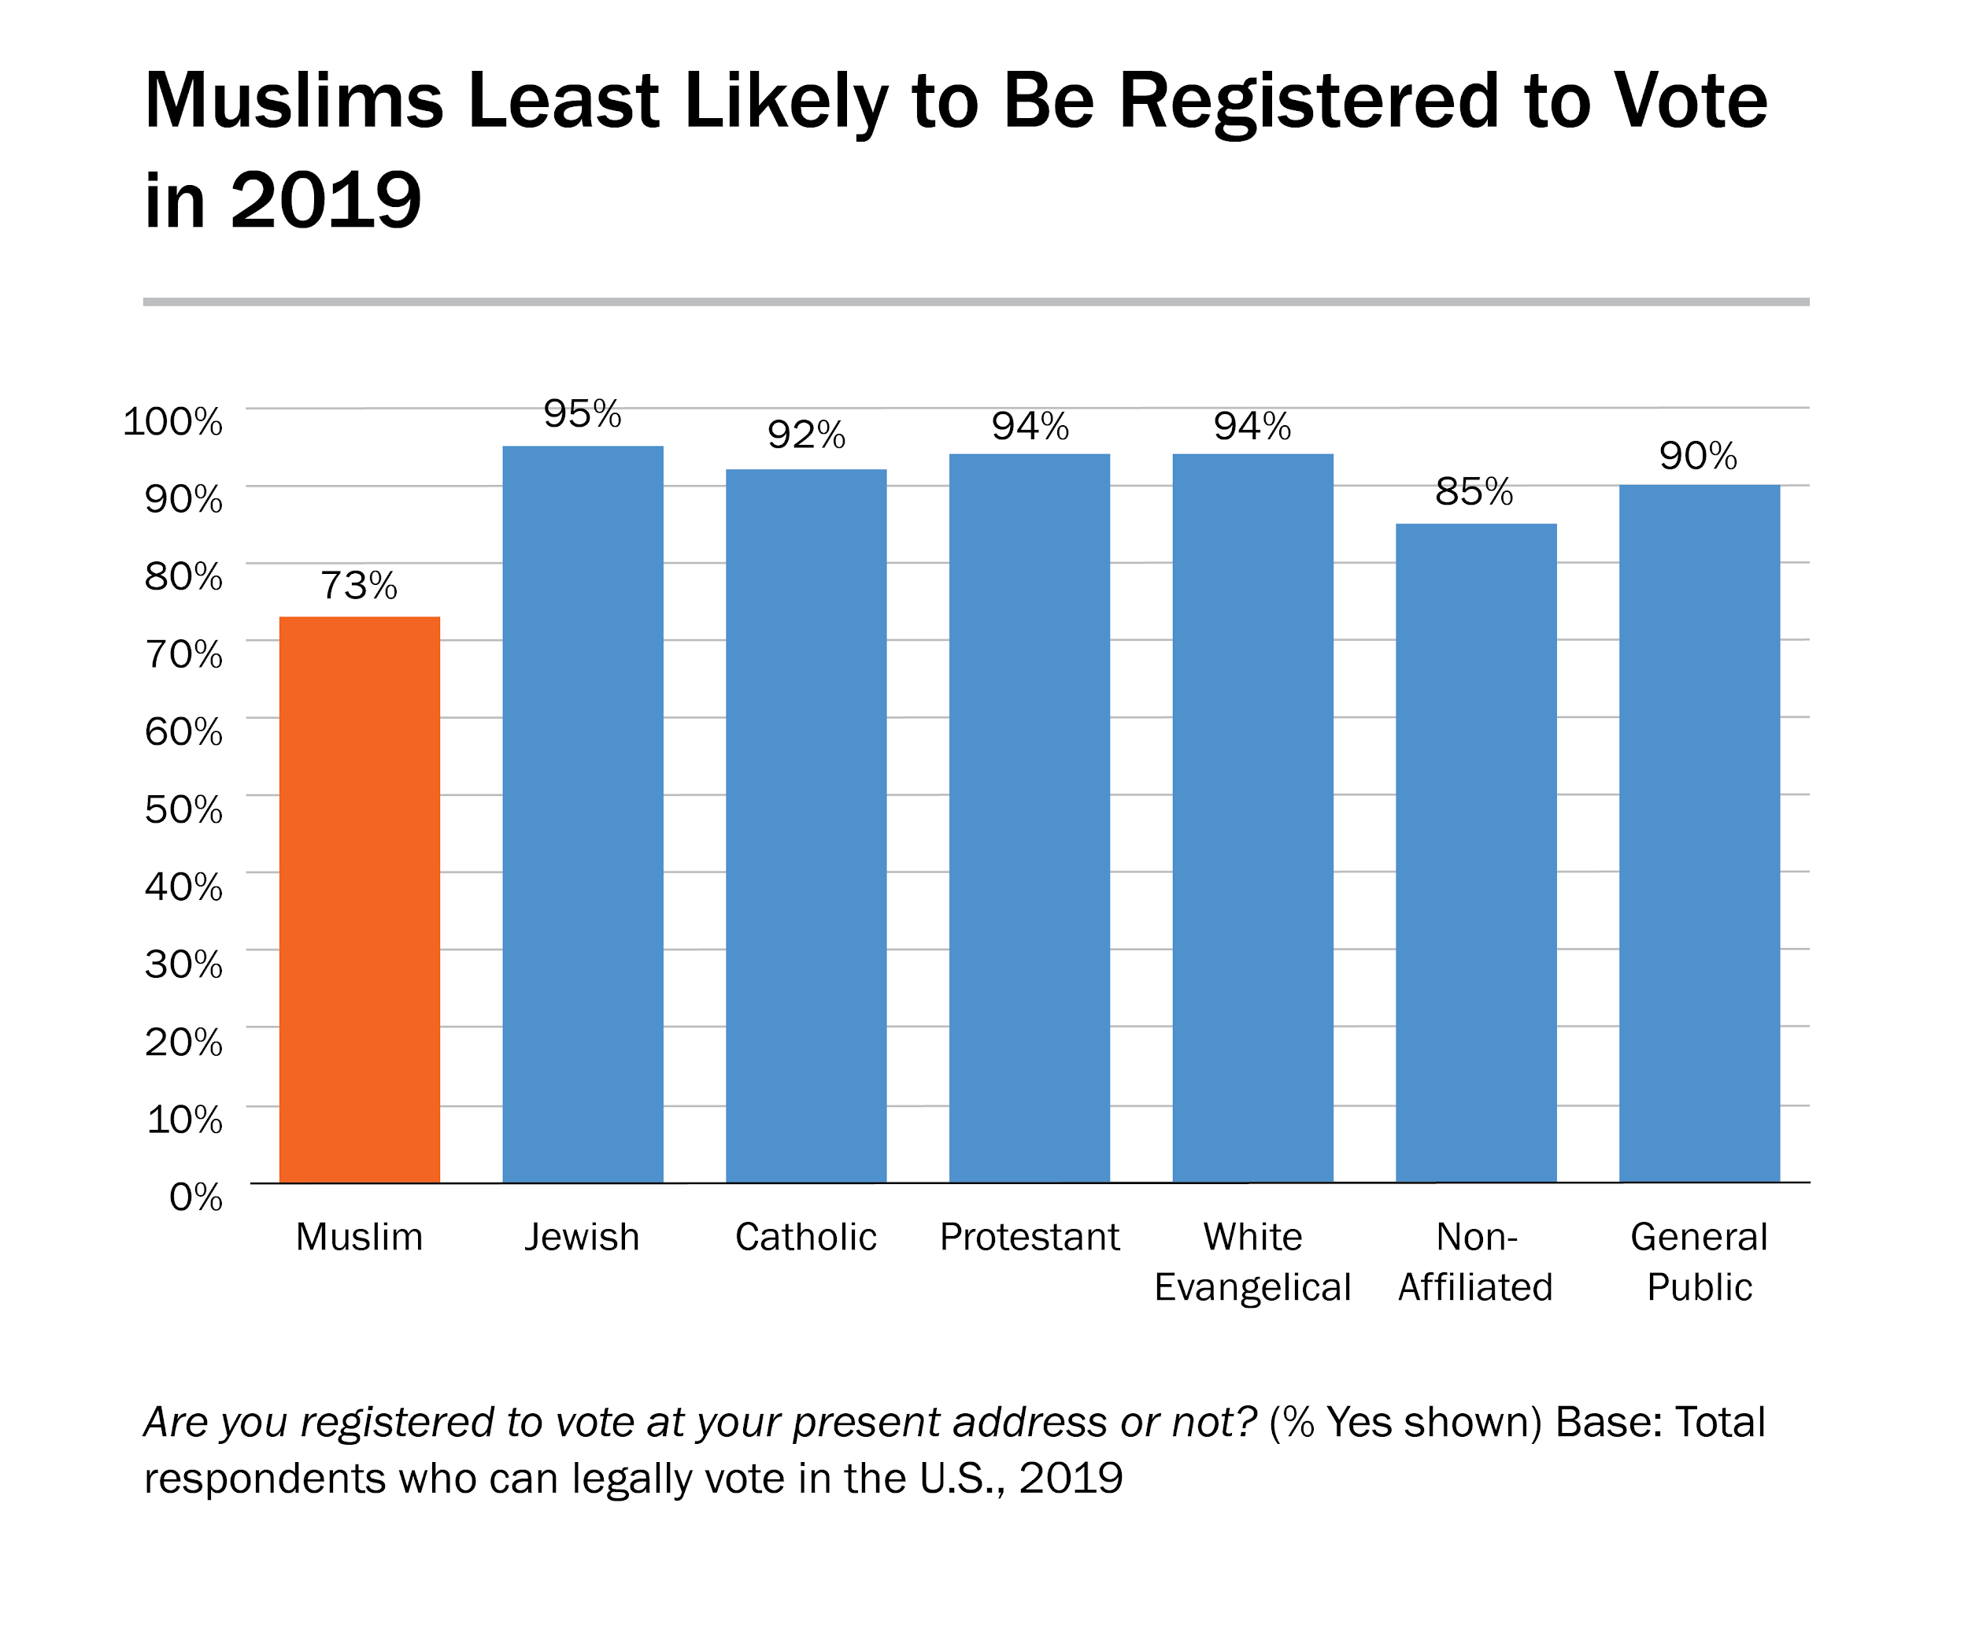

Slide 19
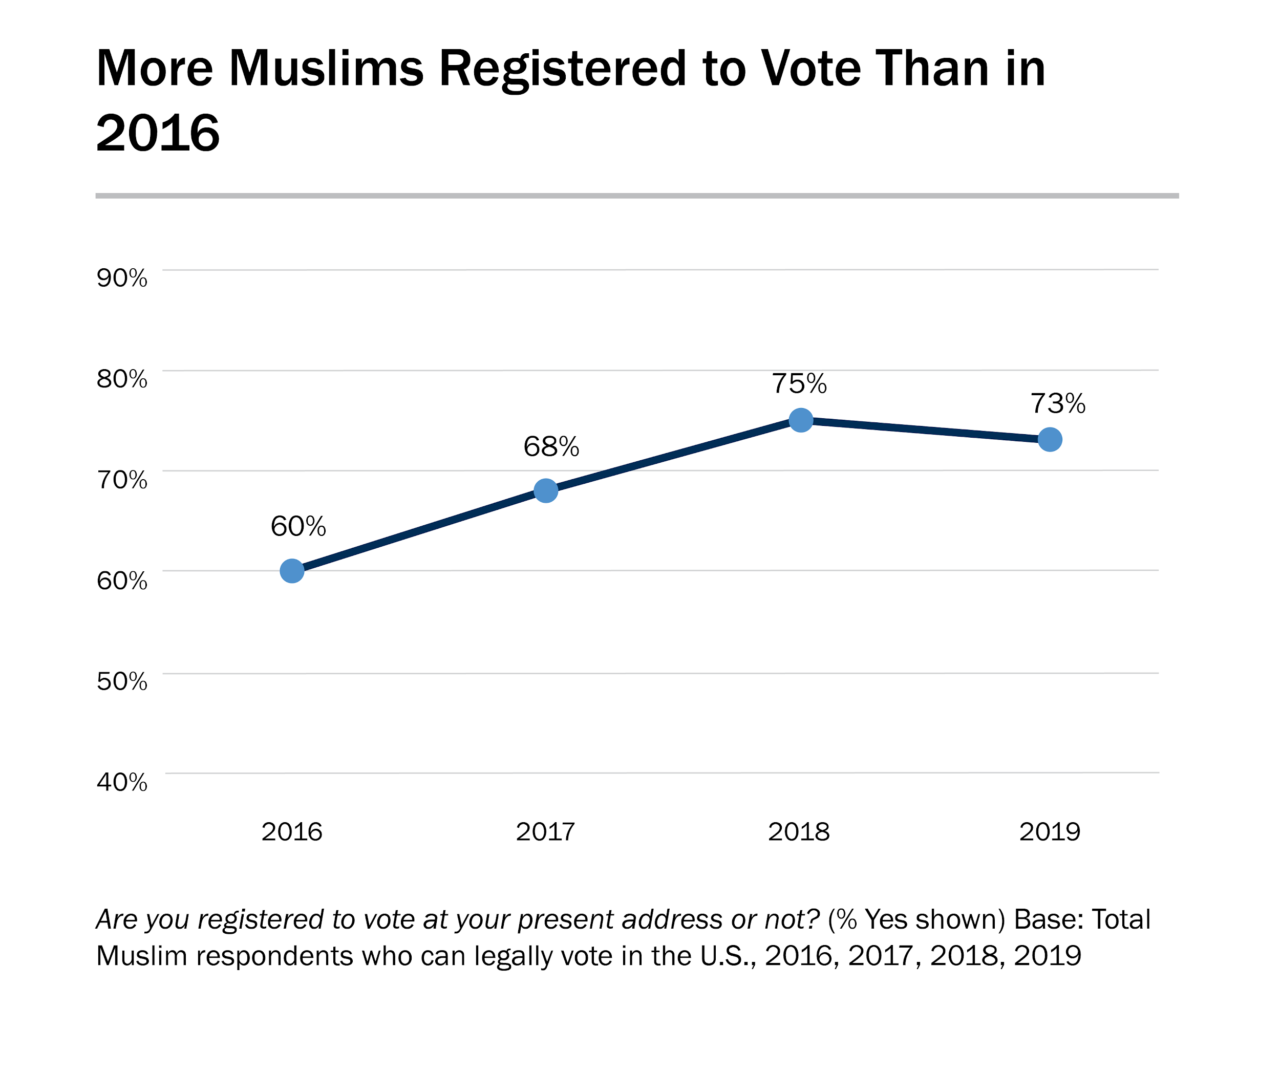

Slide 20
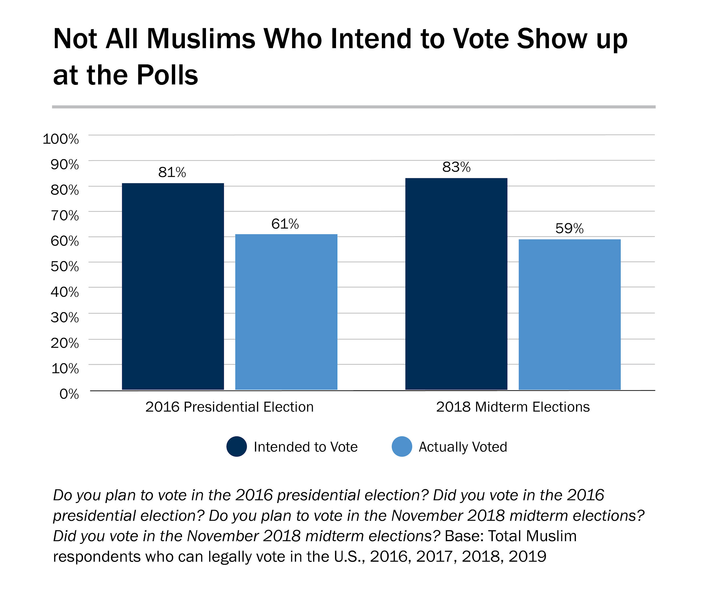

Slide 21
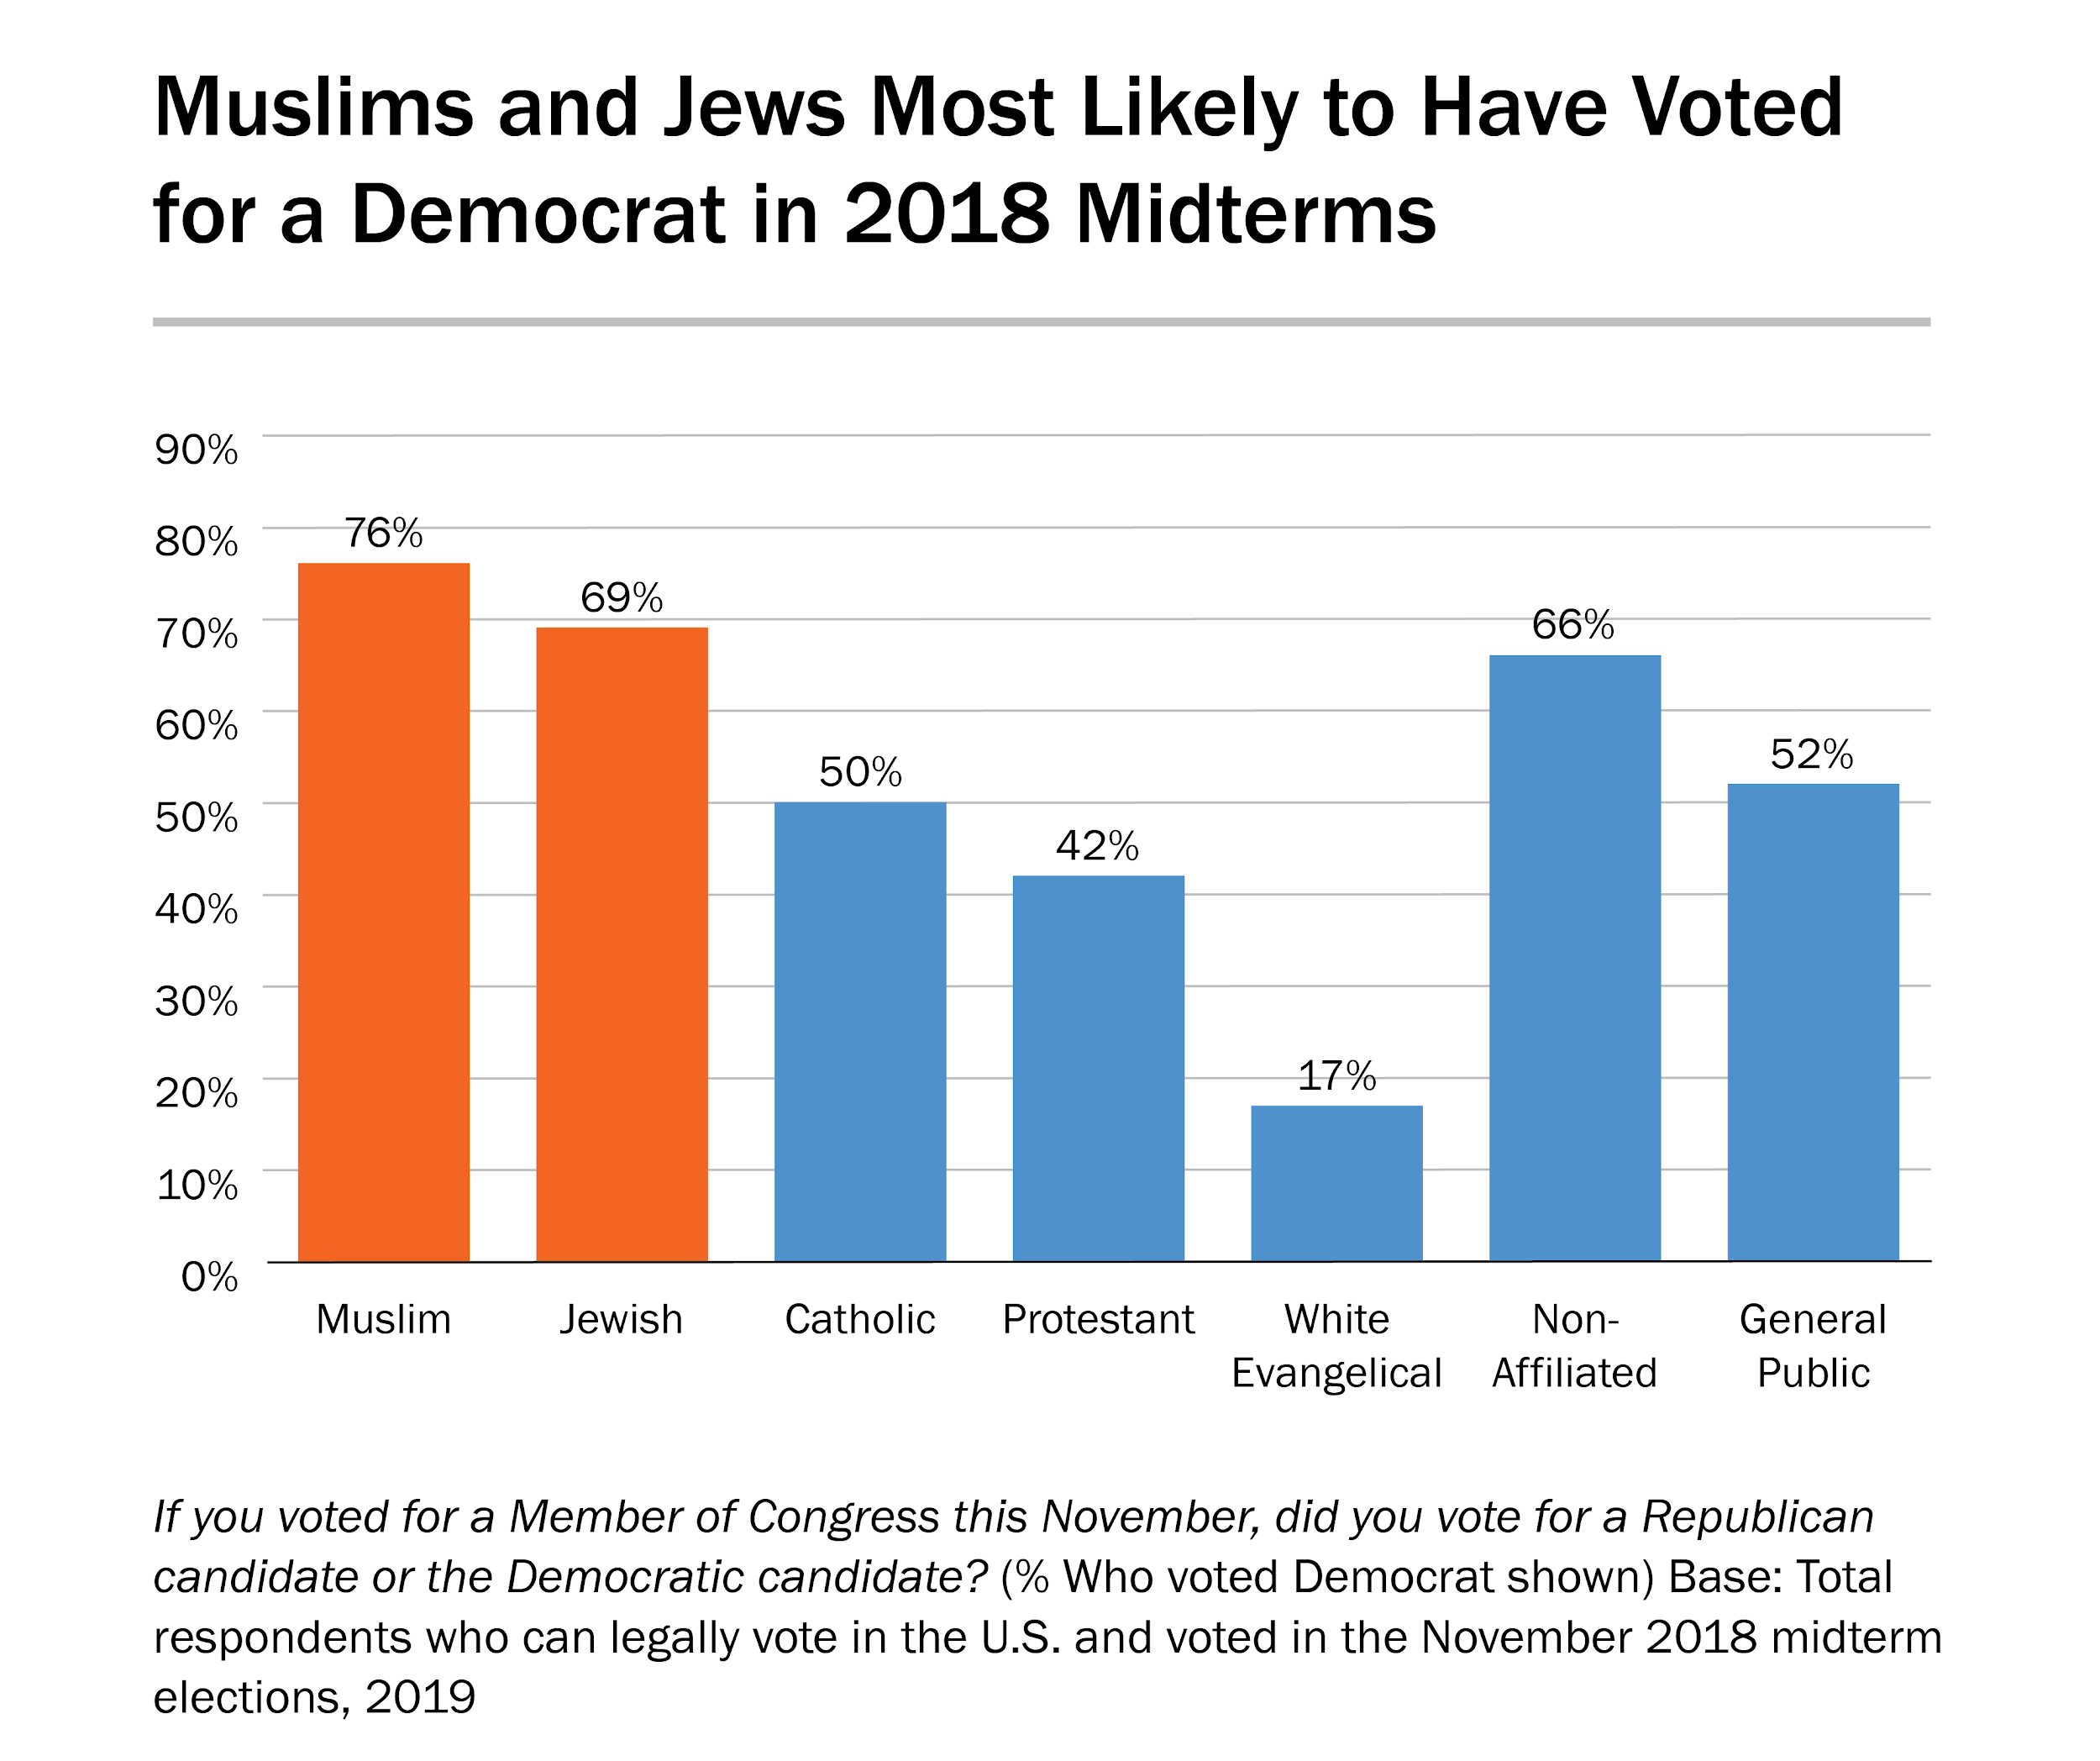

Slide 22
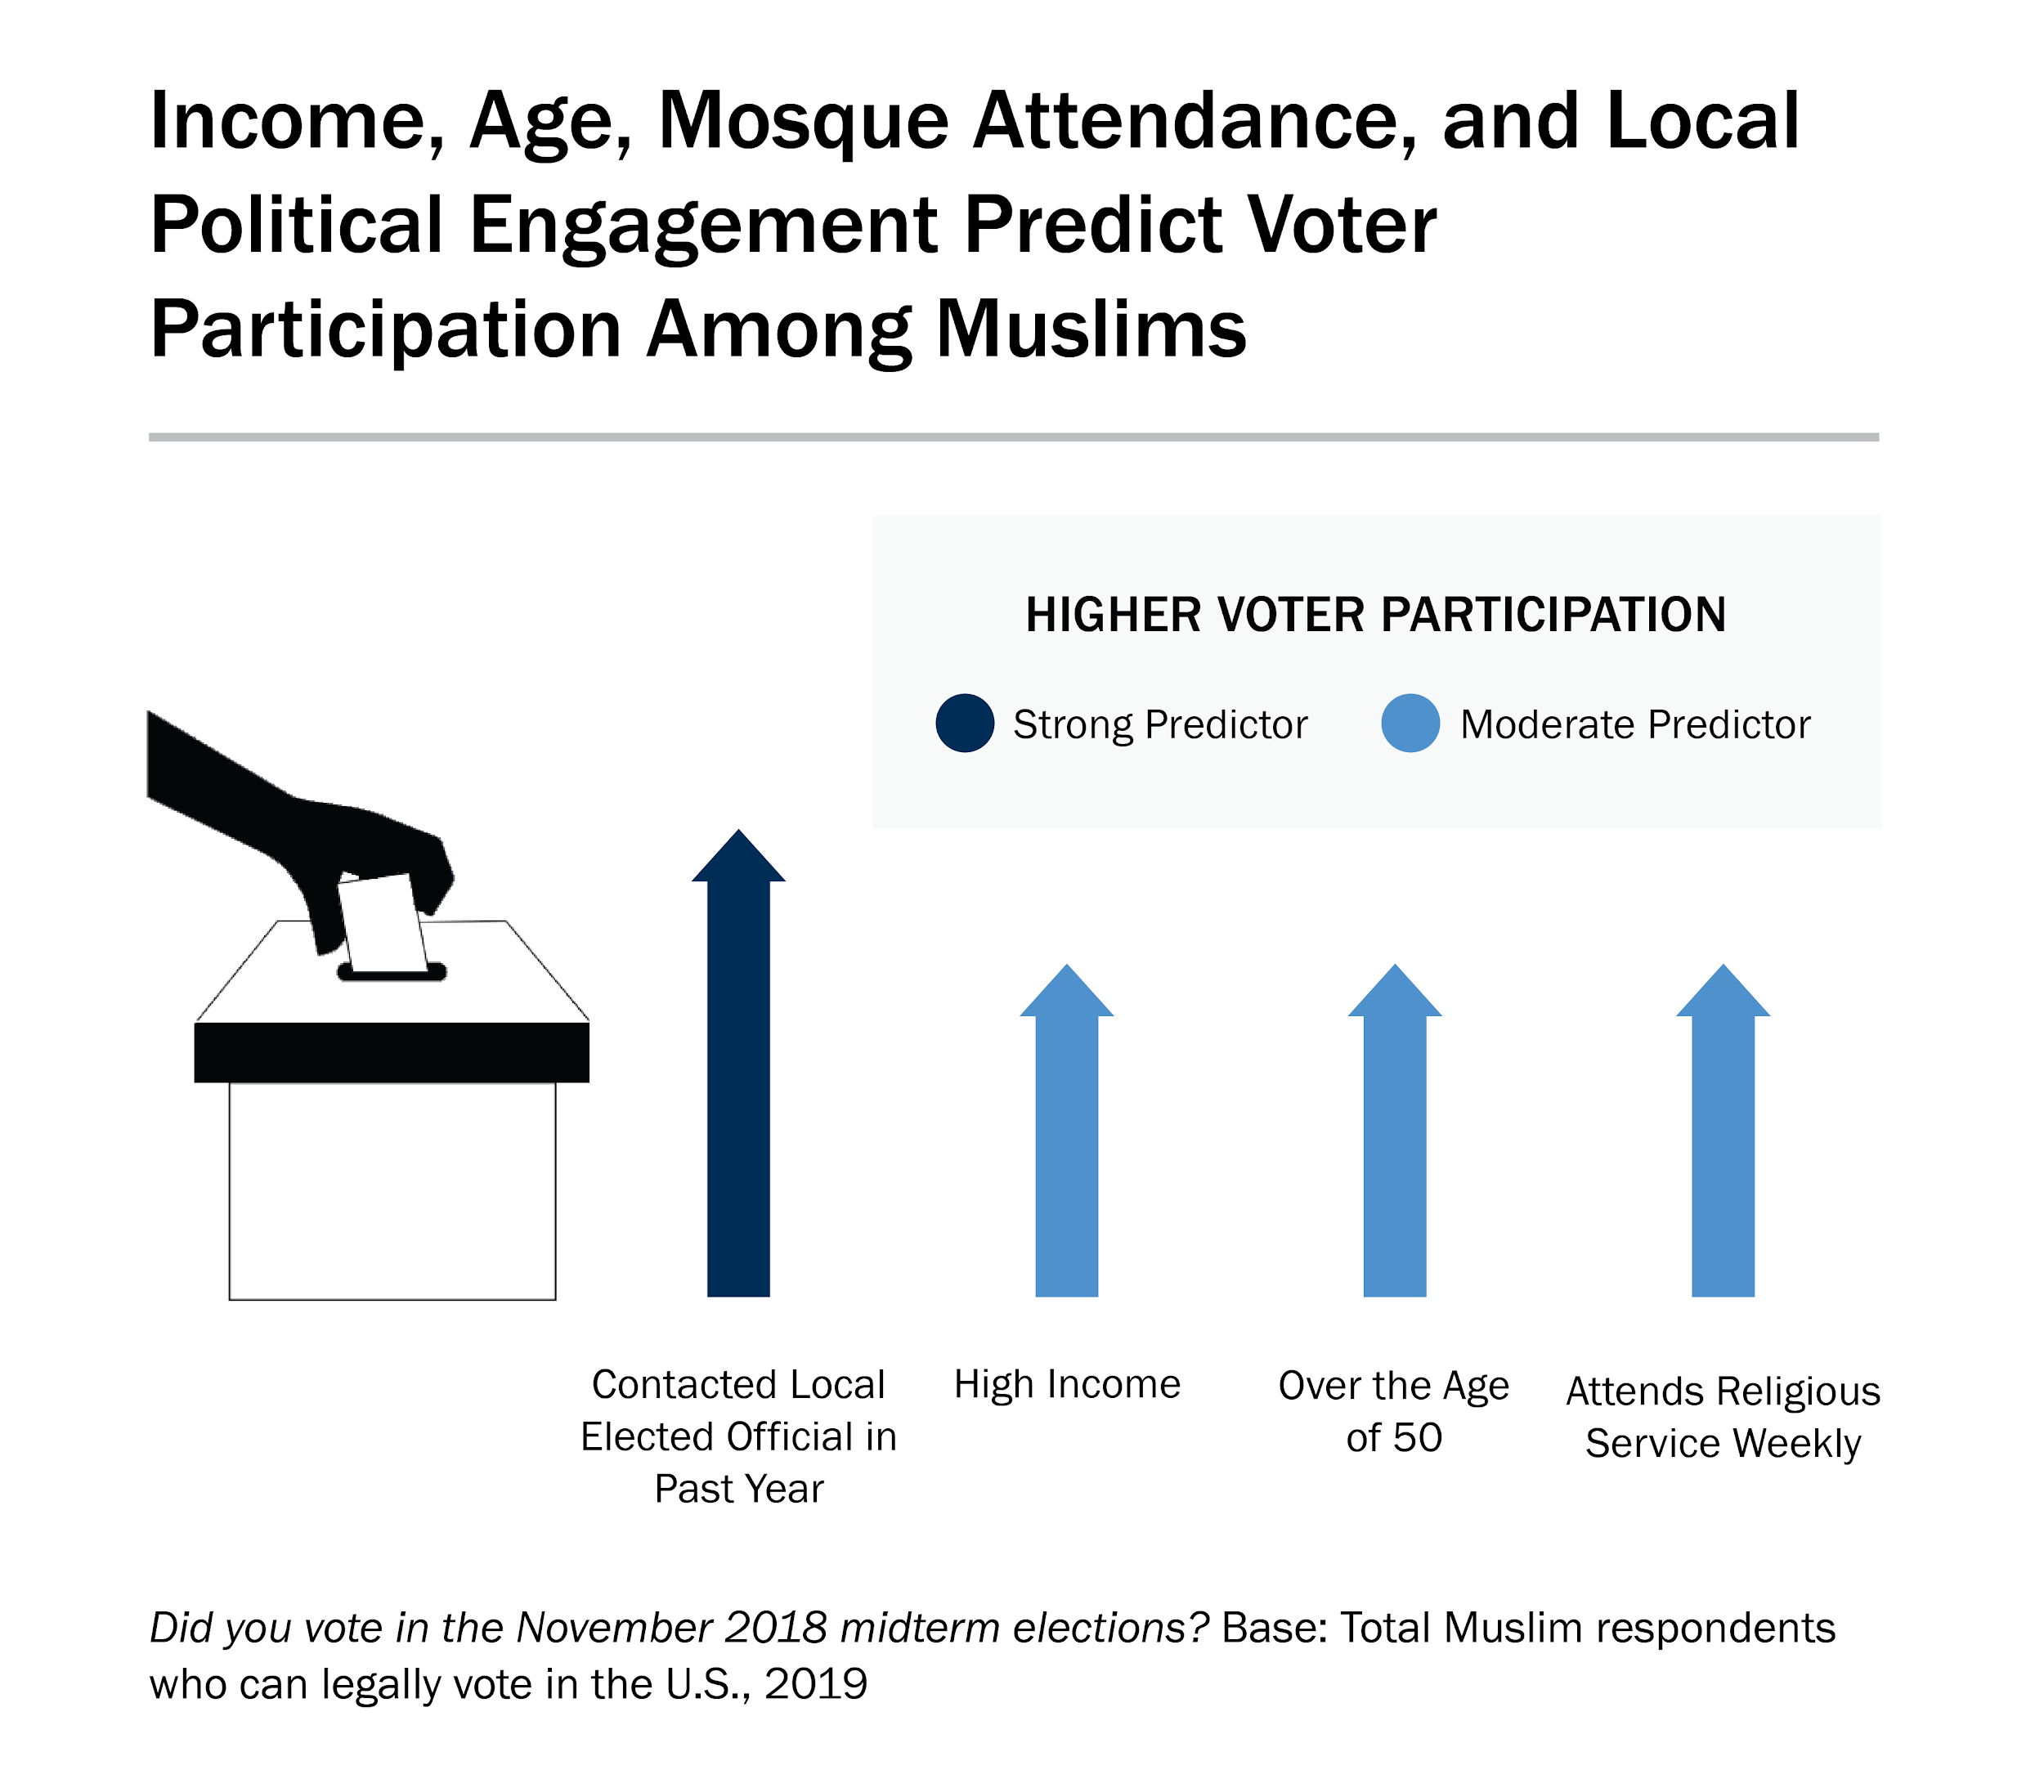

Slide 23
The Islamophobia Index

Slide 24
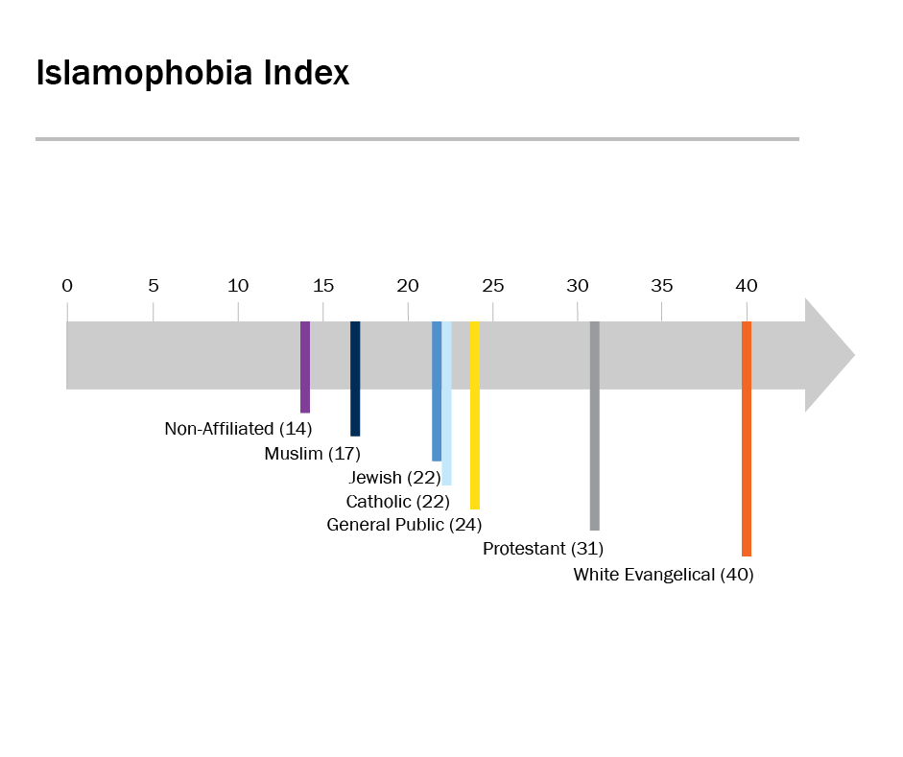
2018

Slide 25
Constructing the Islamophobia Index
The Islamophobia Index measures the level of anti-Muslim sentiment in America by measuring the level of endorsement of the following:
Most Muslims living in the United States are more prone to violence than others.
Most Muslims living in the United States discriminate against women.
Most Muslims living in the United States are hostile to the United States.
Most Muslims living in the United States are less civilized than other people.
Most Muslims living in the United States are partially responsible for acts of violence carried out by other Muslims
Notes:
Anti-Muslim stereotypes (violent, misogynist)
Perceptions of Muslim aggression toward the United States
Degree of Muslim dehumanization (less civilized)
Perceptions of Muslim collective blame (partially responsible for violence committed by another Muslim)

Slide 26
Constructing the Islamophobia Index
For each item, the responses were assigned values from 1 to 5 (Strongly Disagree=1, Strongly Agree=5).
Each respondent’s answers to the five-question battery were then added together to form an index (Cronbach’s Alpha=.83) ranging from 5 to 25.
For ease of presentation, this total was then rescaled from 0 to 100 (with 0 as the least negative and 100 as the most).

Slide 27
The Anatomy of the Islamophobia Index
The Islamophobia Index calculates reported levels of agreement with the following statements:
Most Muslims living in the United States are more prone to violence than others.
Most Muslims living in the United States discriminate against women.
Most Muslims living in the United States are hostile to the United States.
Most Muslims living in the United States are less civilized than other people.
Most Muslims living in the United States are partially responsible for acts of violence carried out by other Muslims

Slide 28
Why These Questions?
ISPU analysts chose these five variables based on previous research linking these perceptions with greater tolerance for anti-Muslim policies such as mosque surveillance, racial profiling and greater scrutiny of Muslims at airports, the so-called Muslim ban, and even taking away voting rights from Americans who are Muslims.
These five measures are not meant to cover the totality of public Islamophobia, which can and does include many other false beliefs about Muslims. They are instead meant to offer an evidence-based measure of five perceptions known to link to acceptance of discriminatory policies.

Slide 29
Islamophobia Inches Up
Islamophobia among the general public inched up from
24 in 2018 to 28 in 2019.

Slide 30
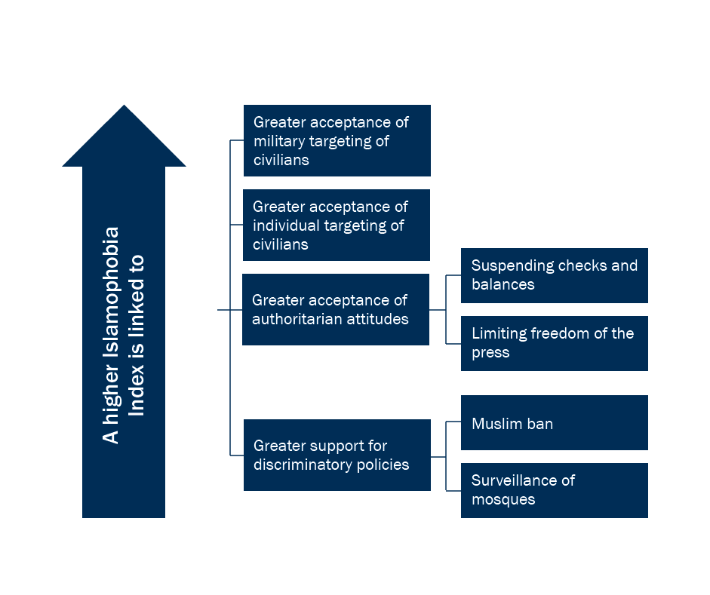
Islamophobia Is Bad for Democracy and Security

Slide 31
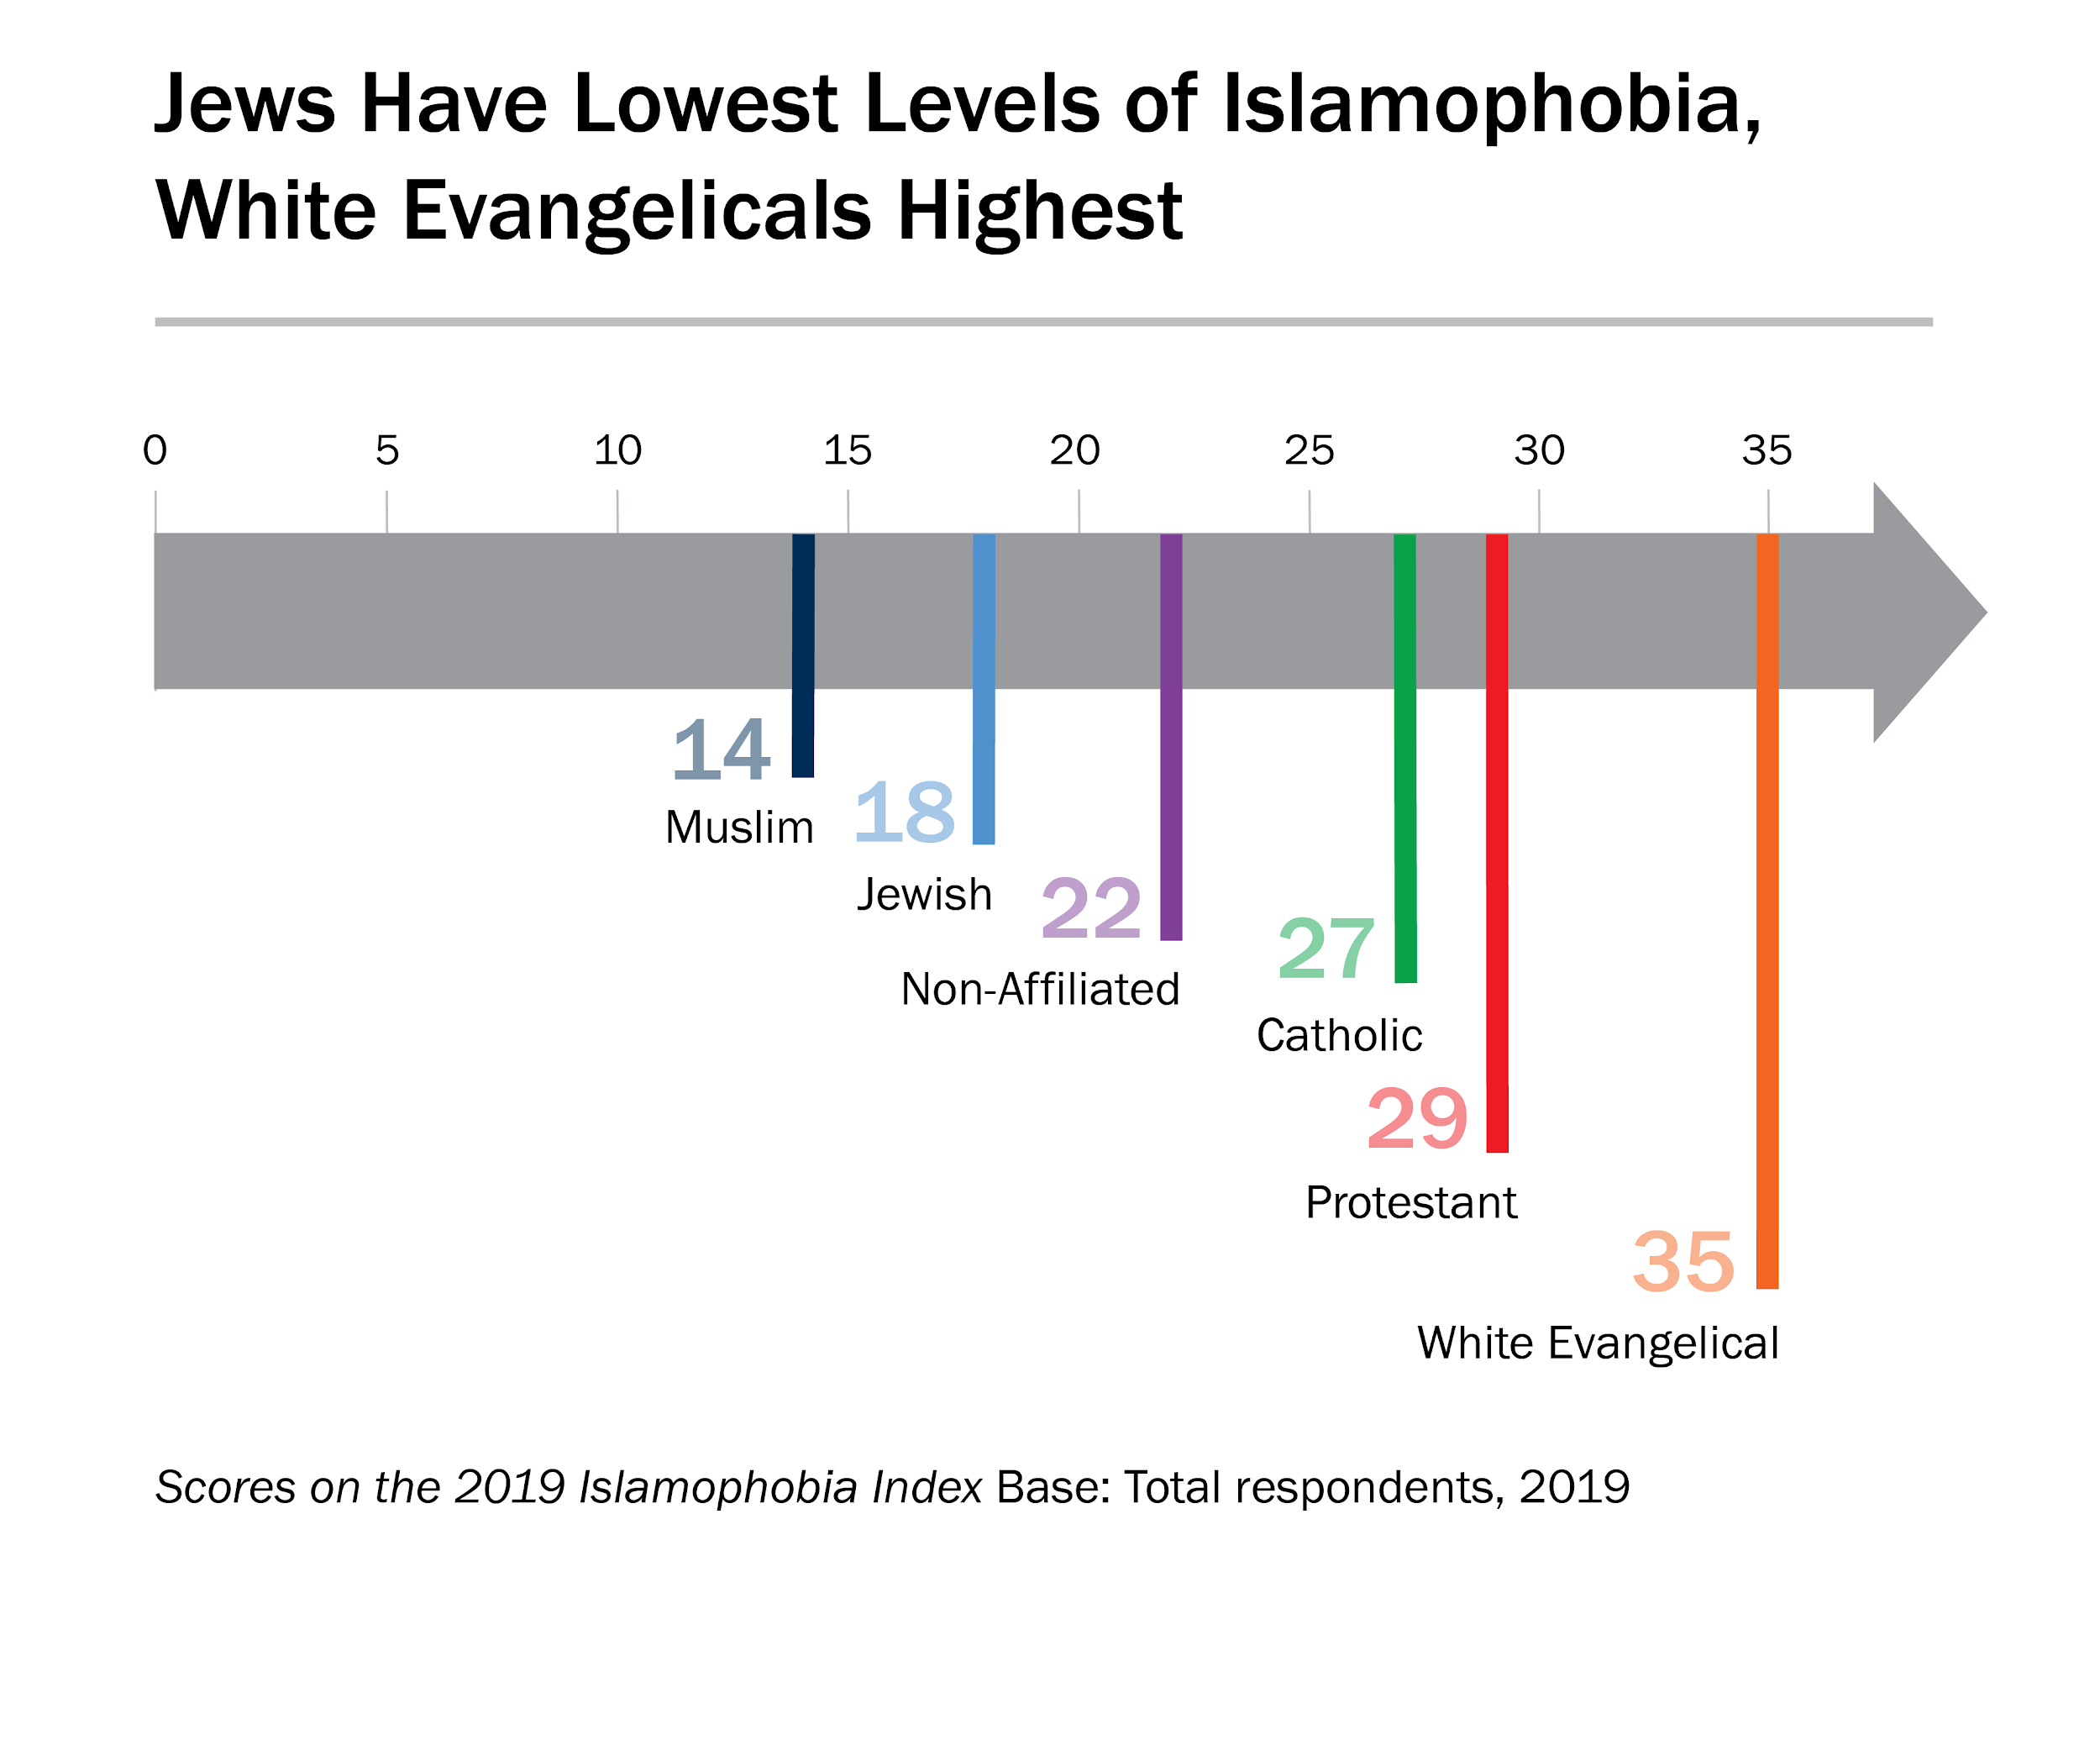

Slide 33
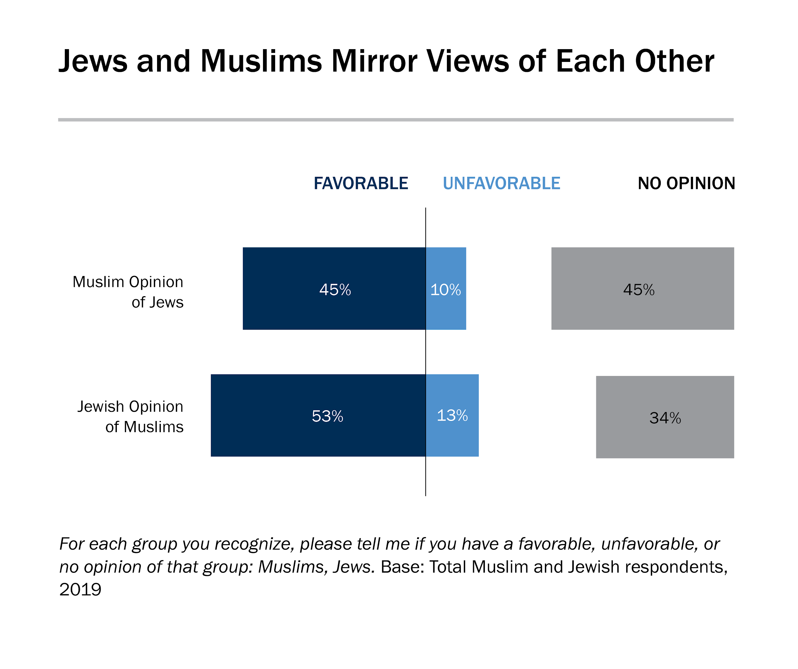

Slide 34
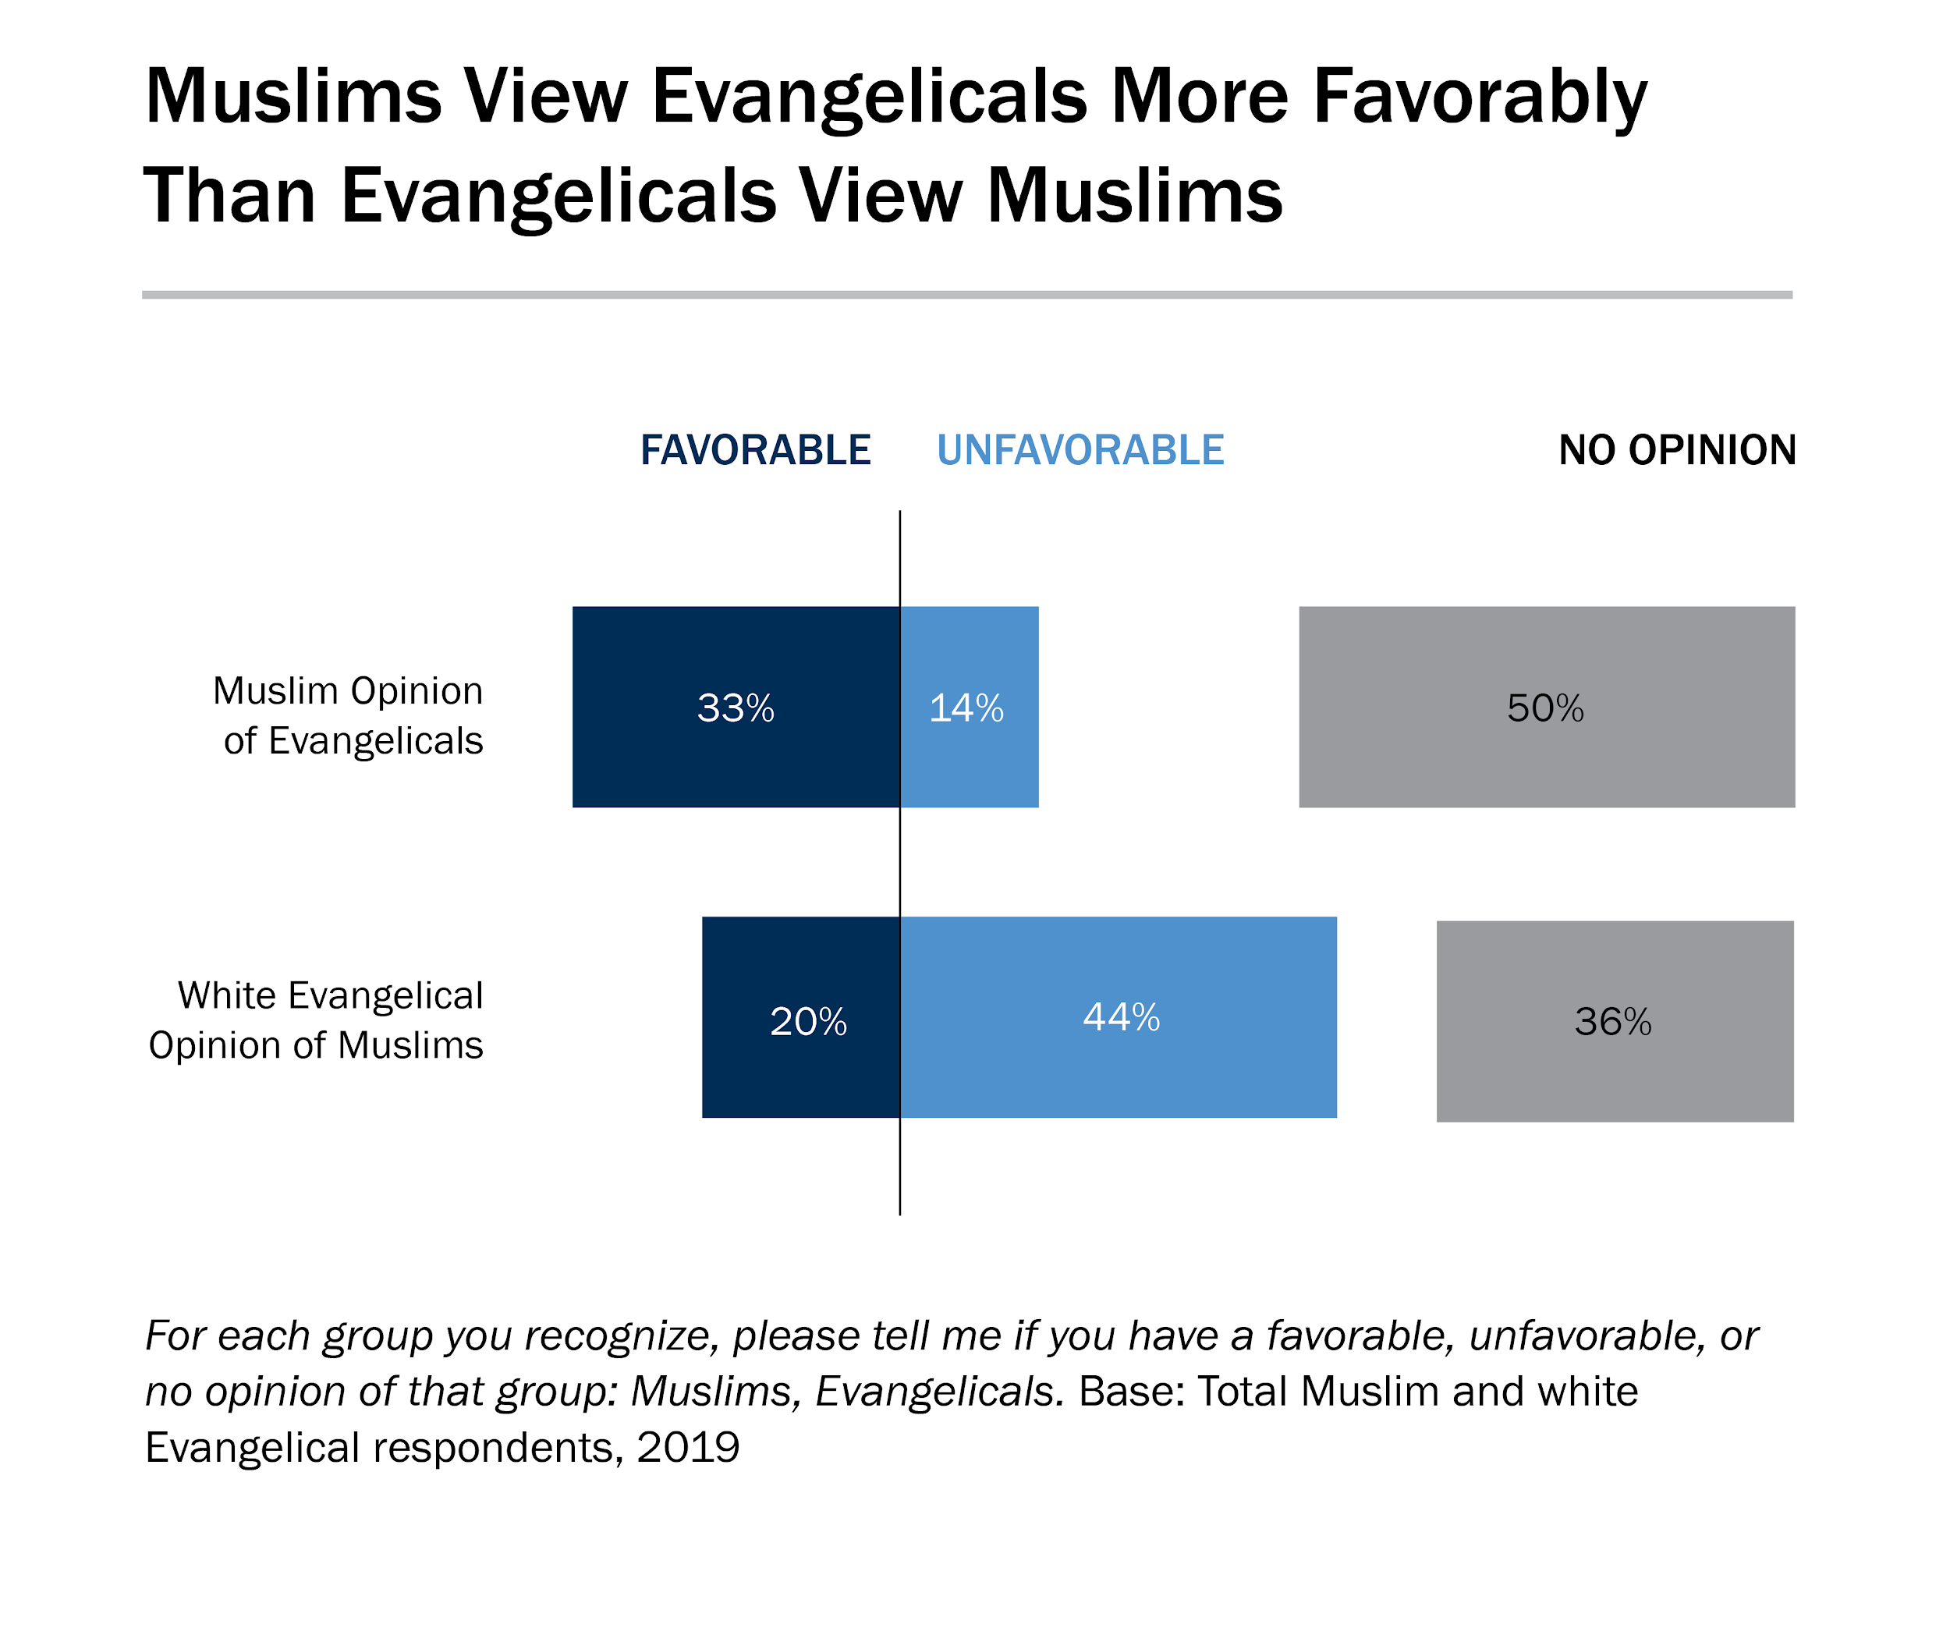

Slide 35
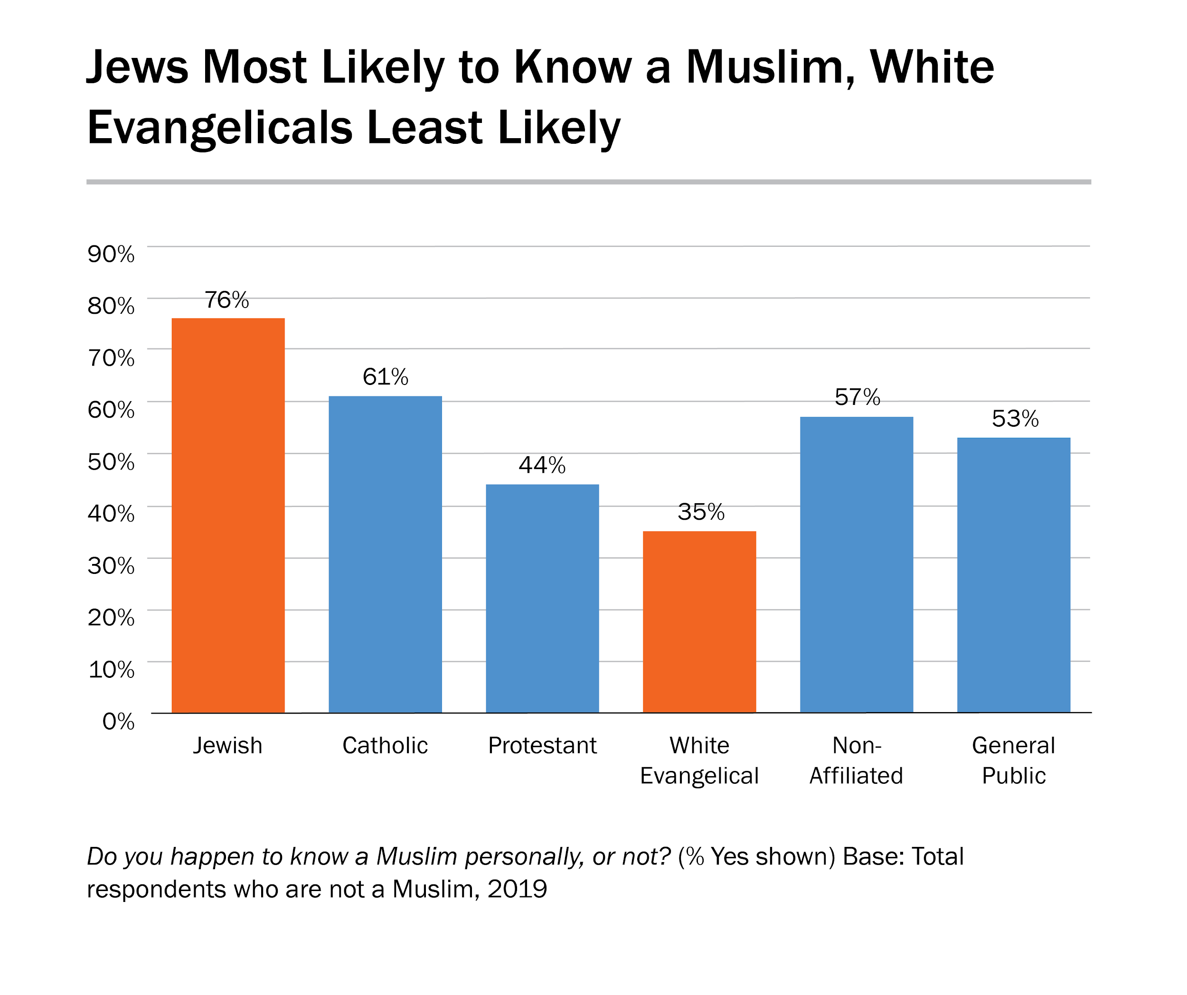

Slide 36
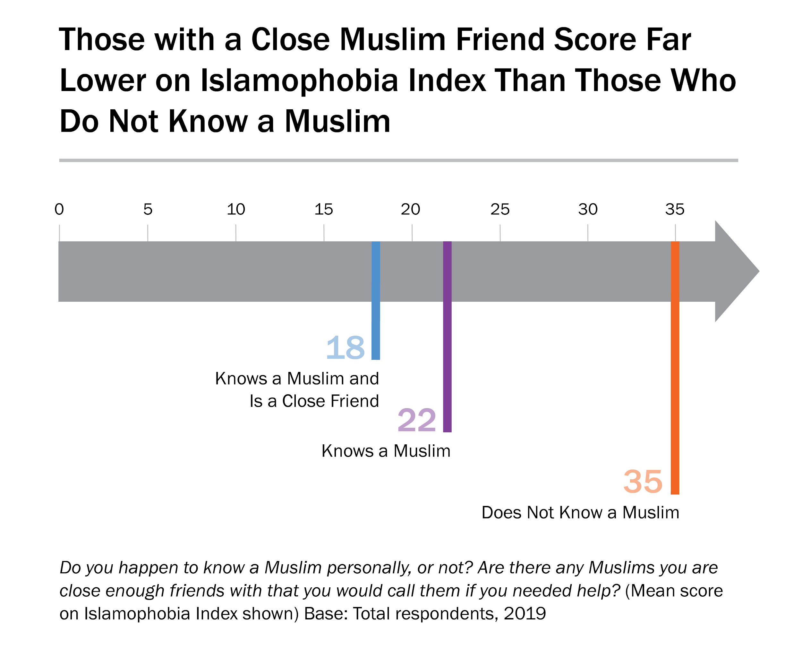

Slide 37
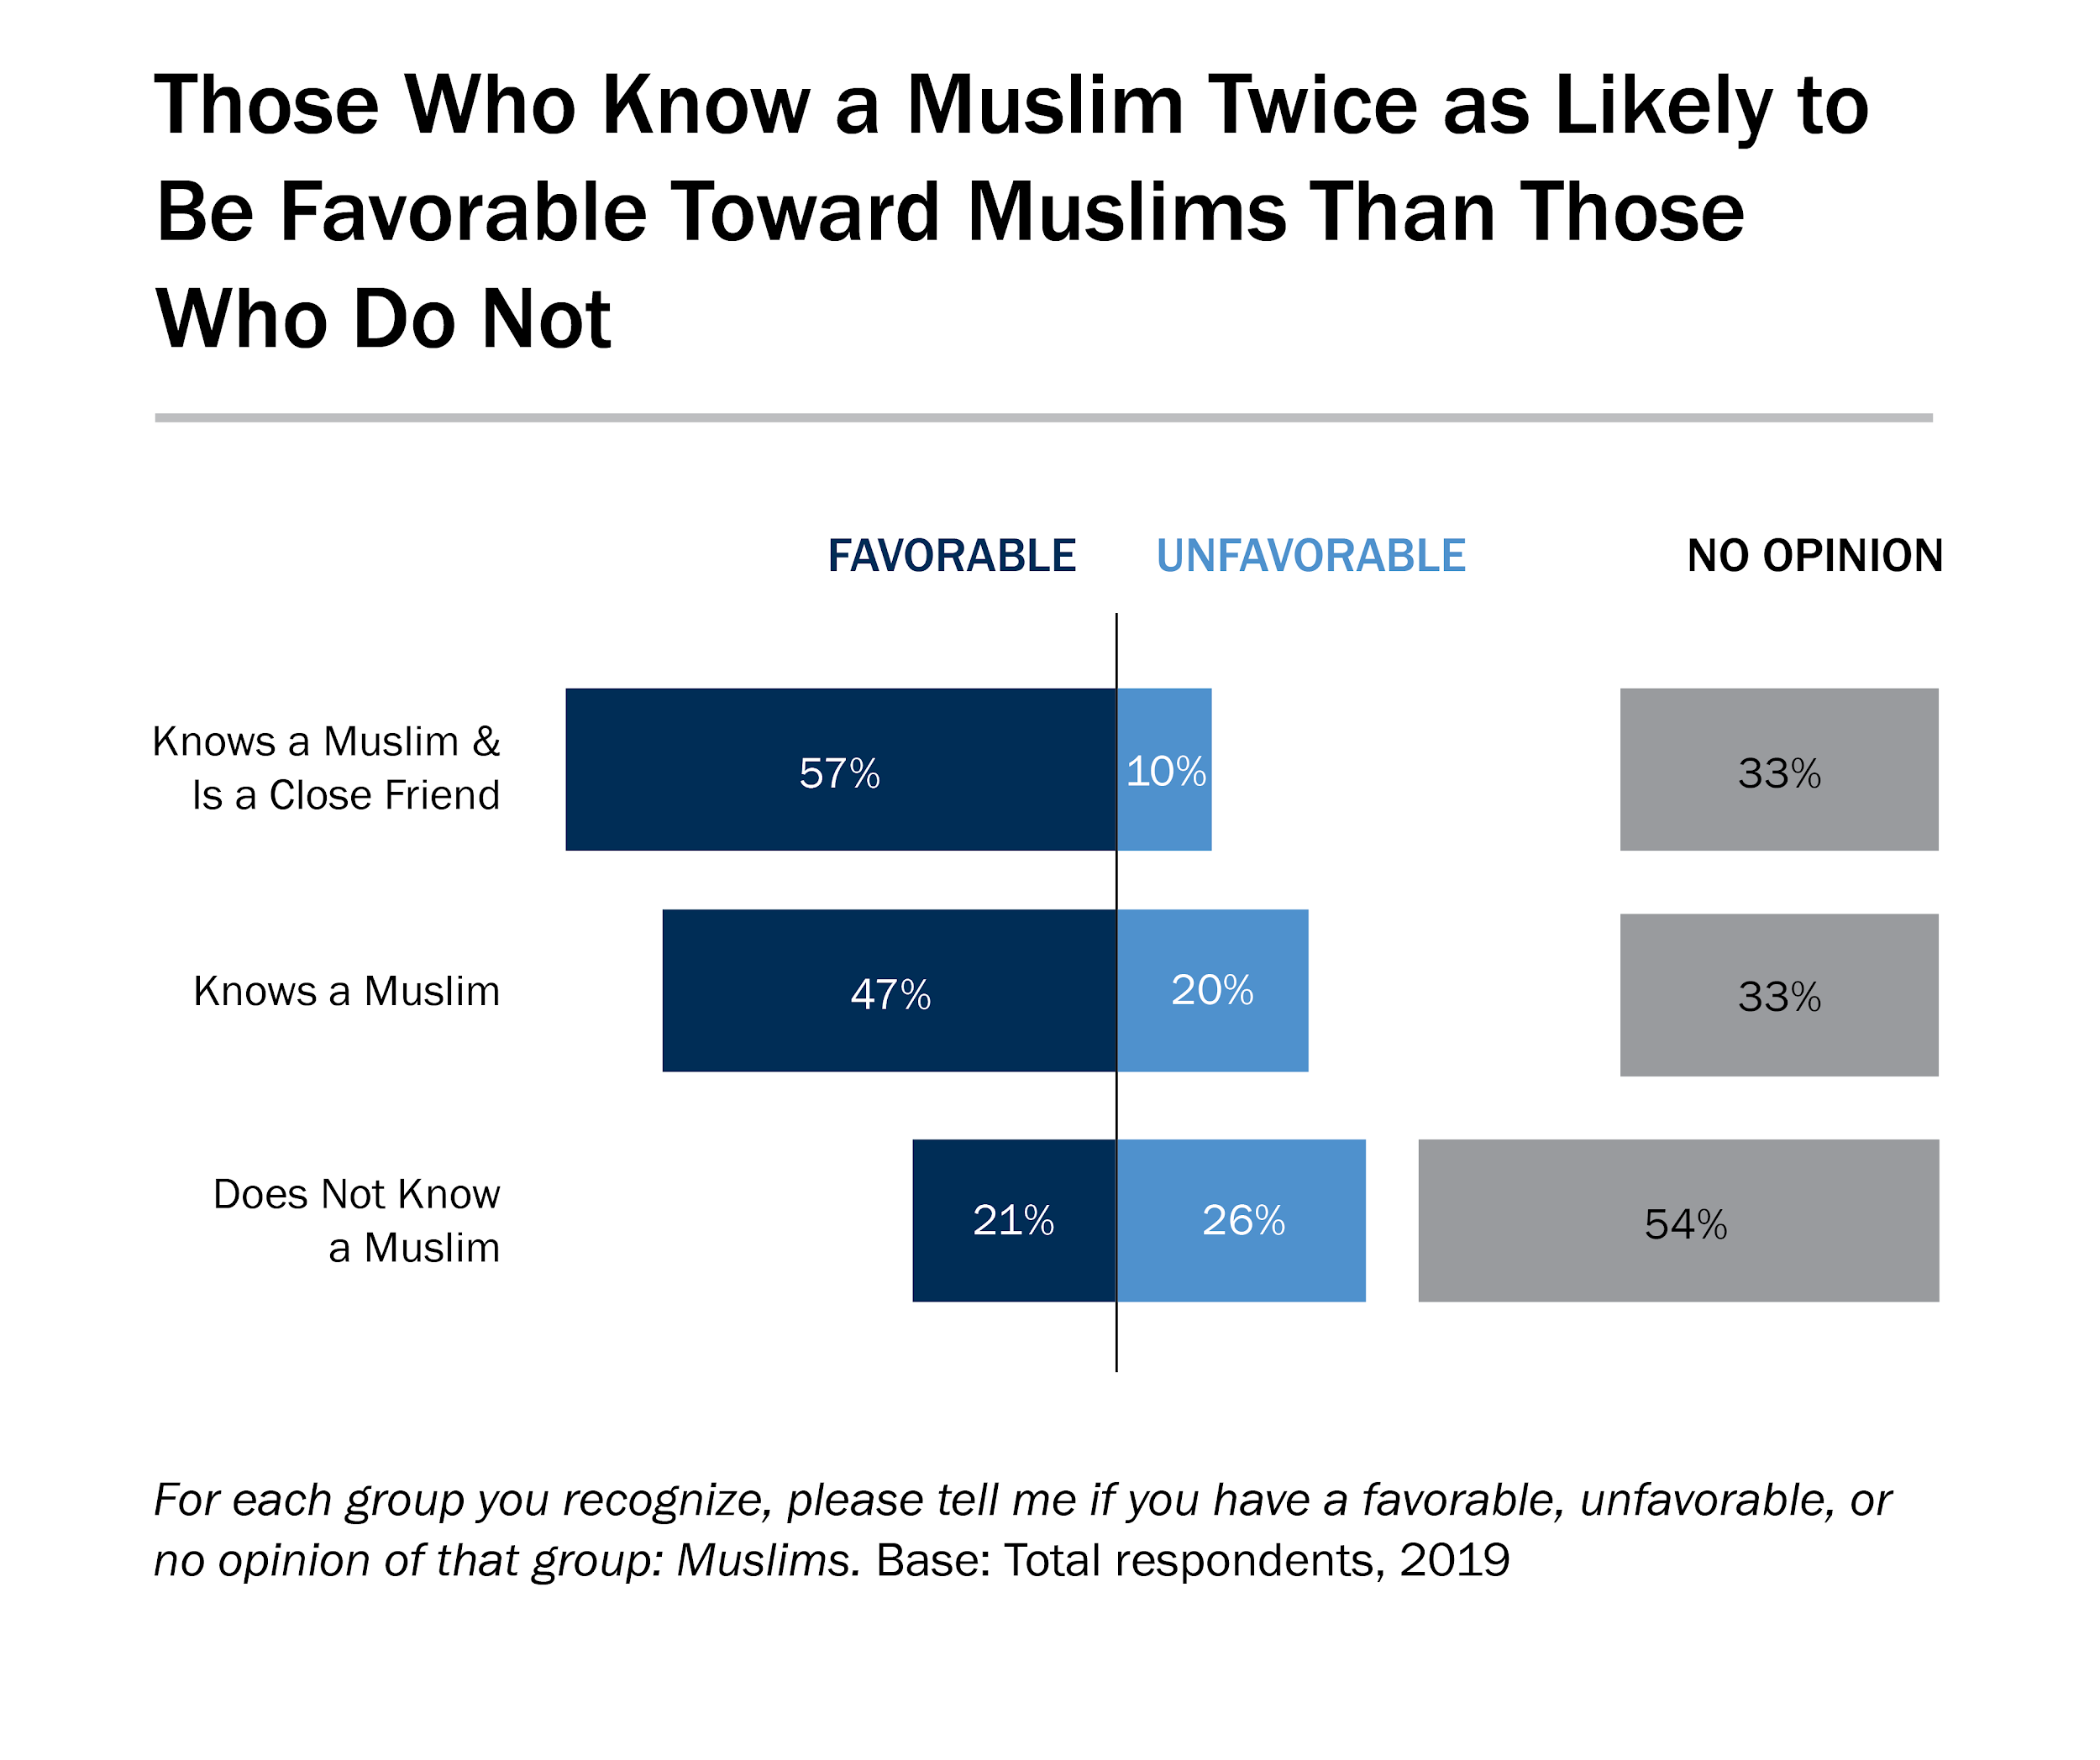

Slide 38
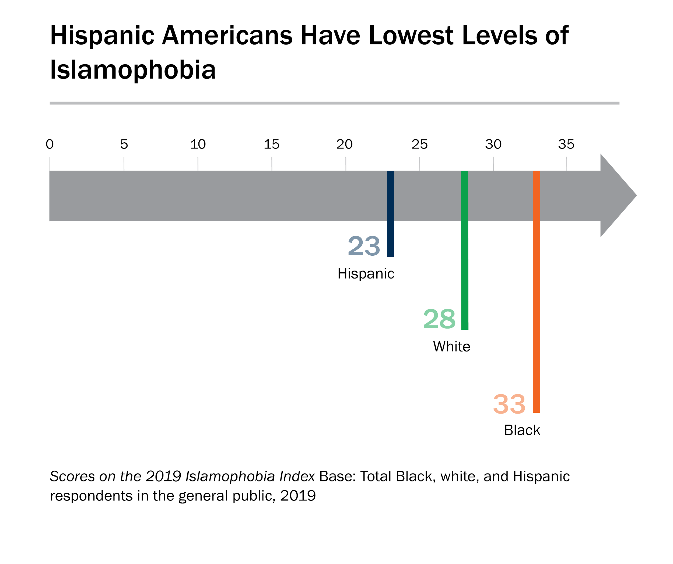

Slide 39
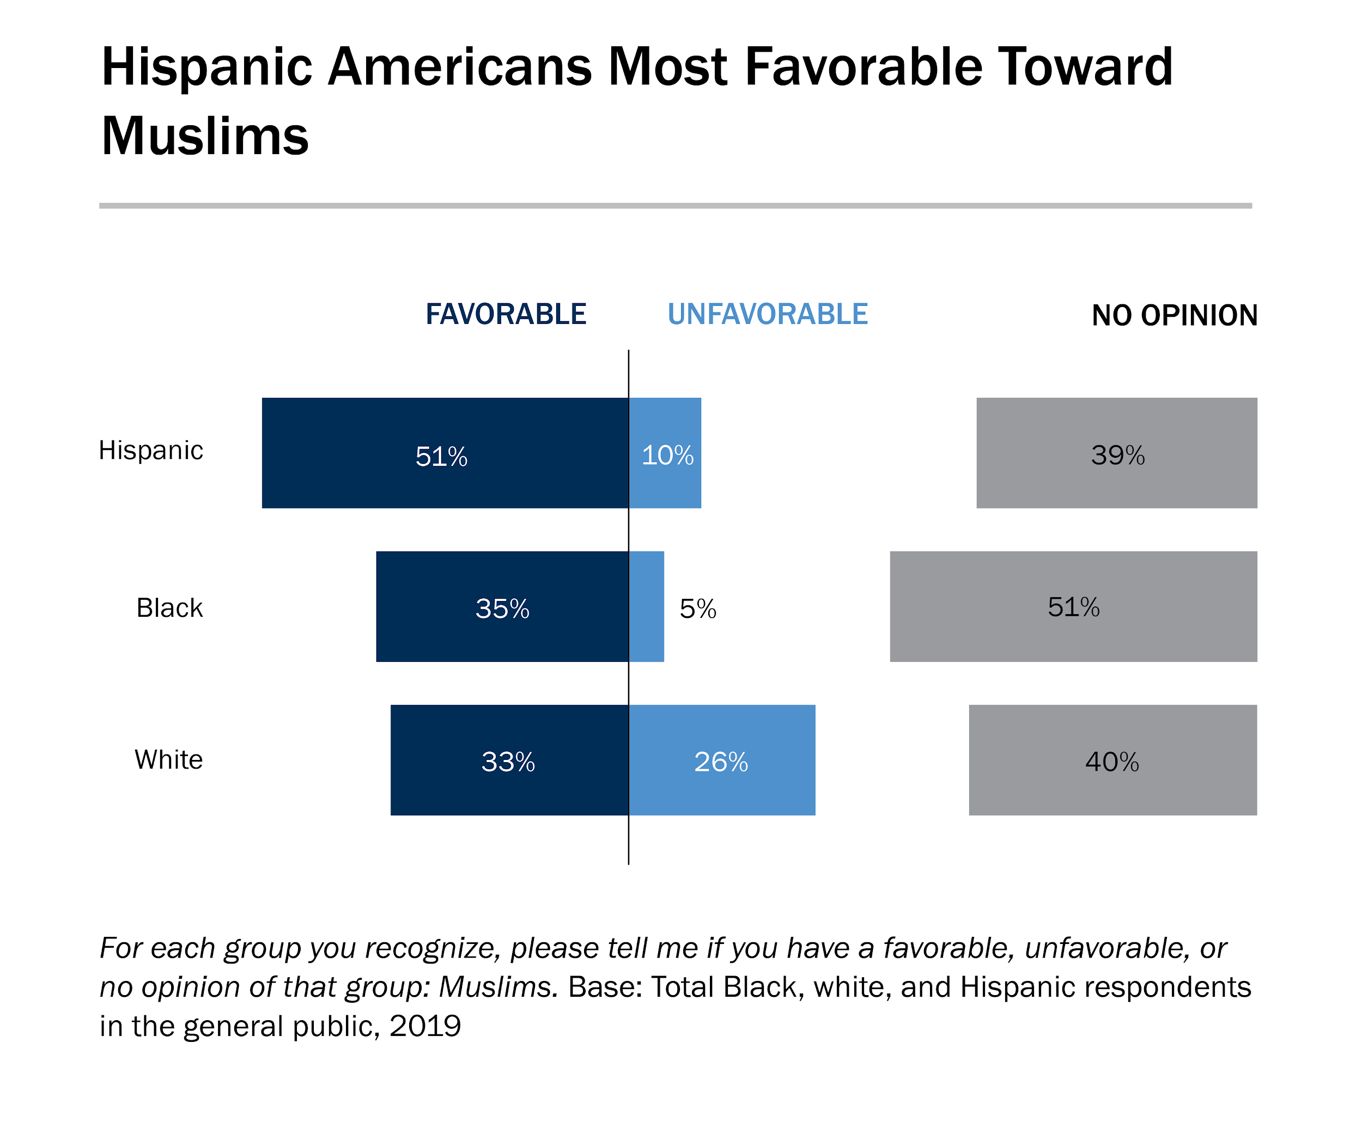

Slide 41
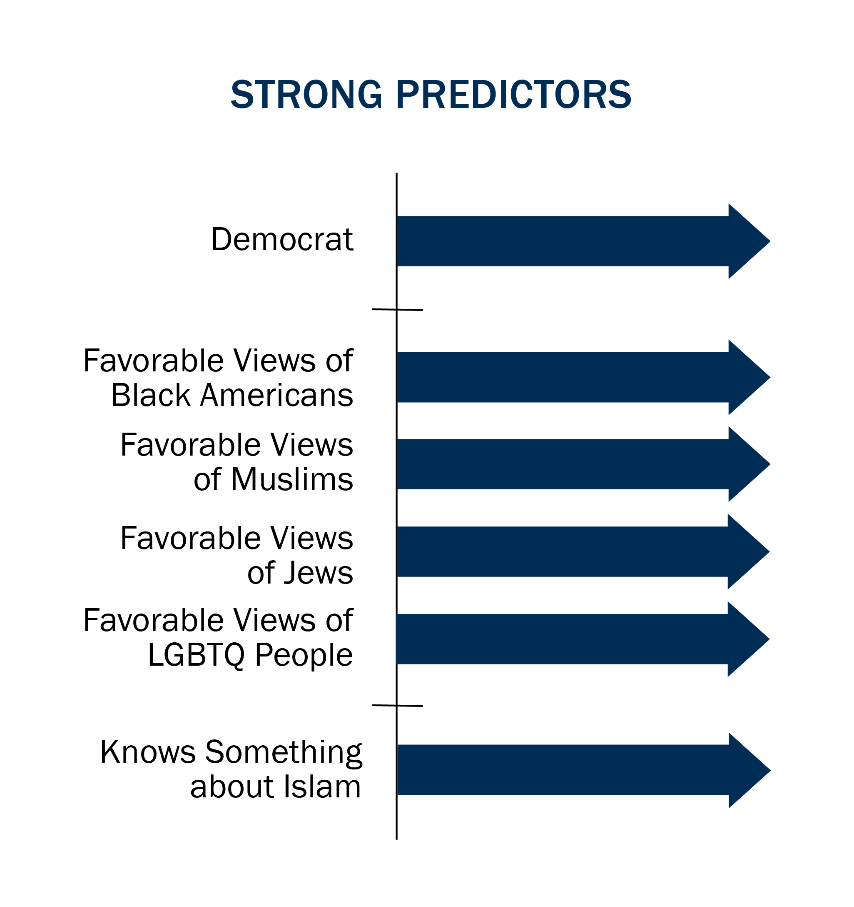
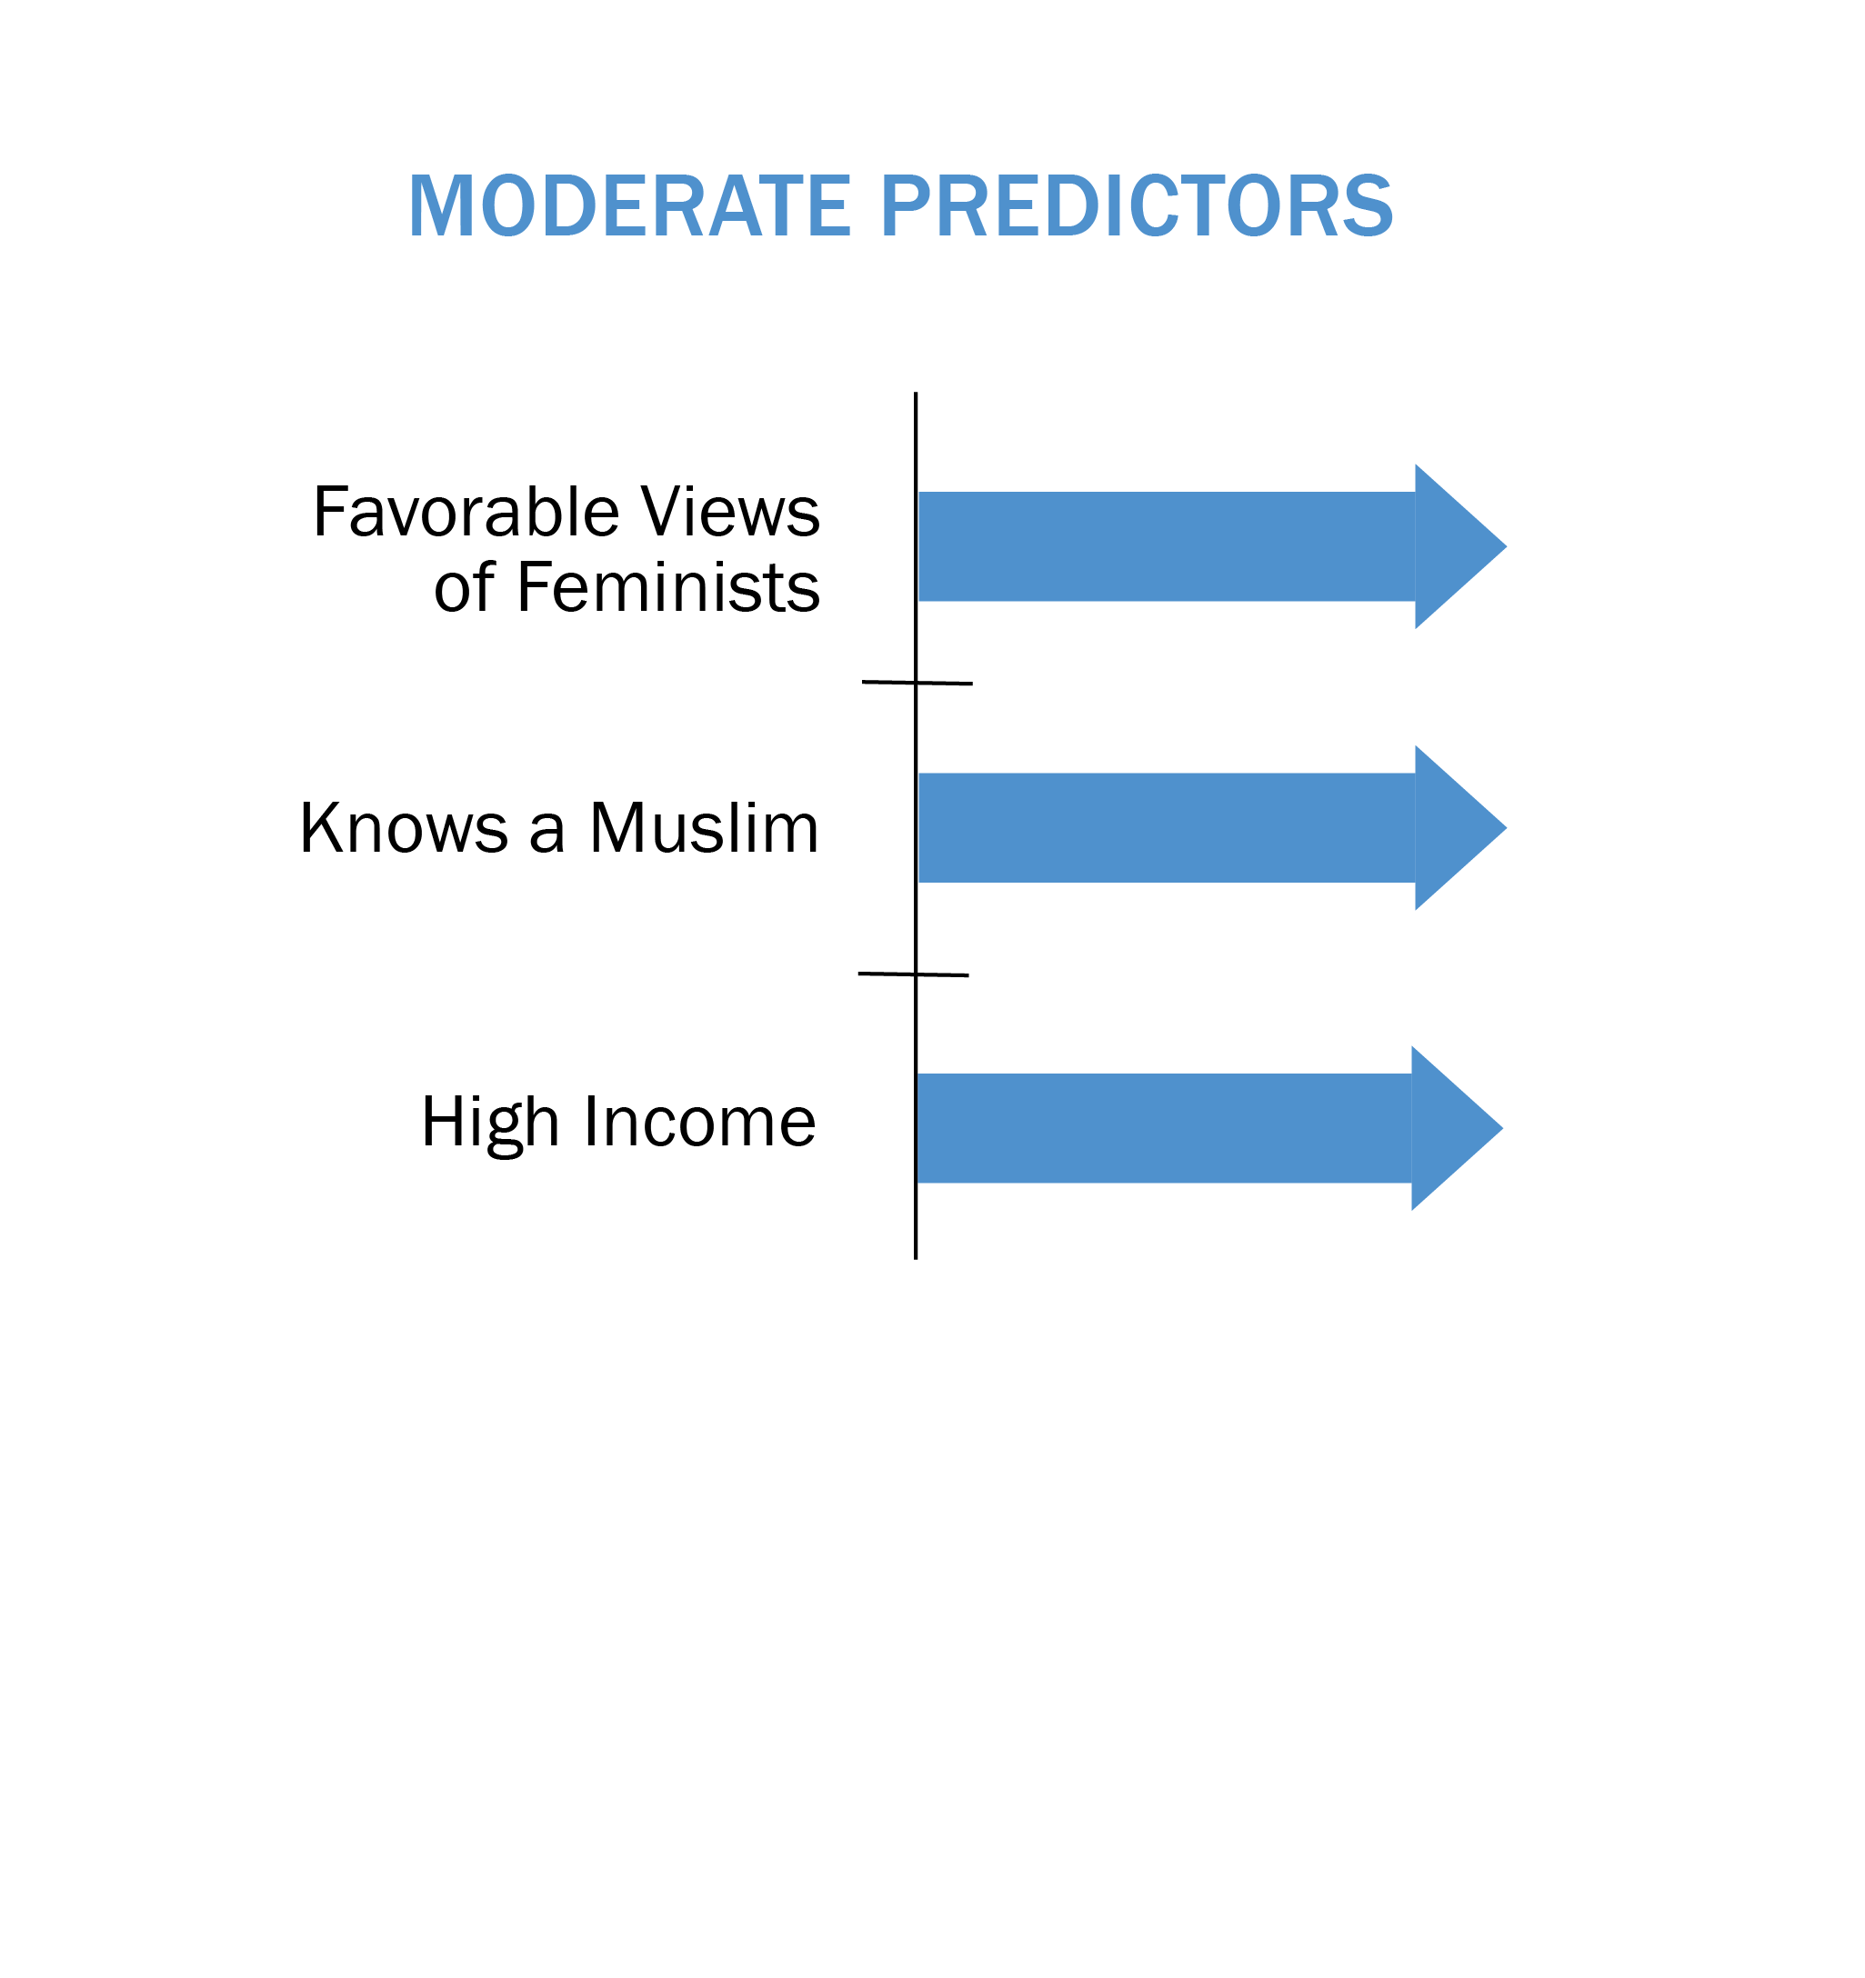
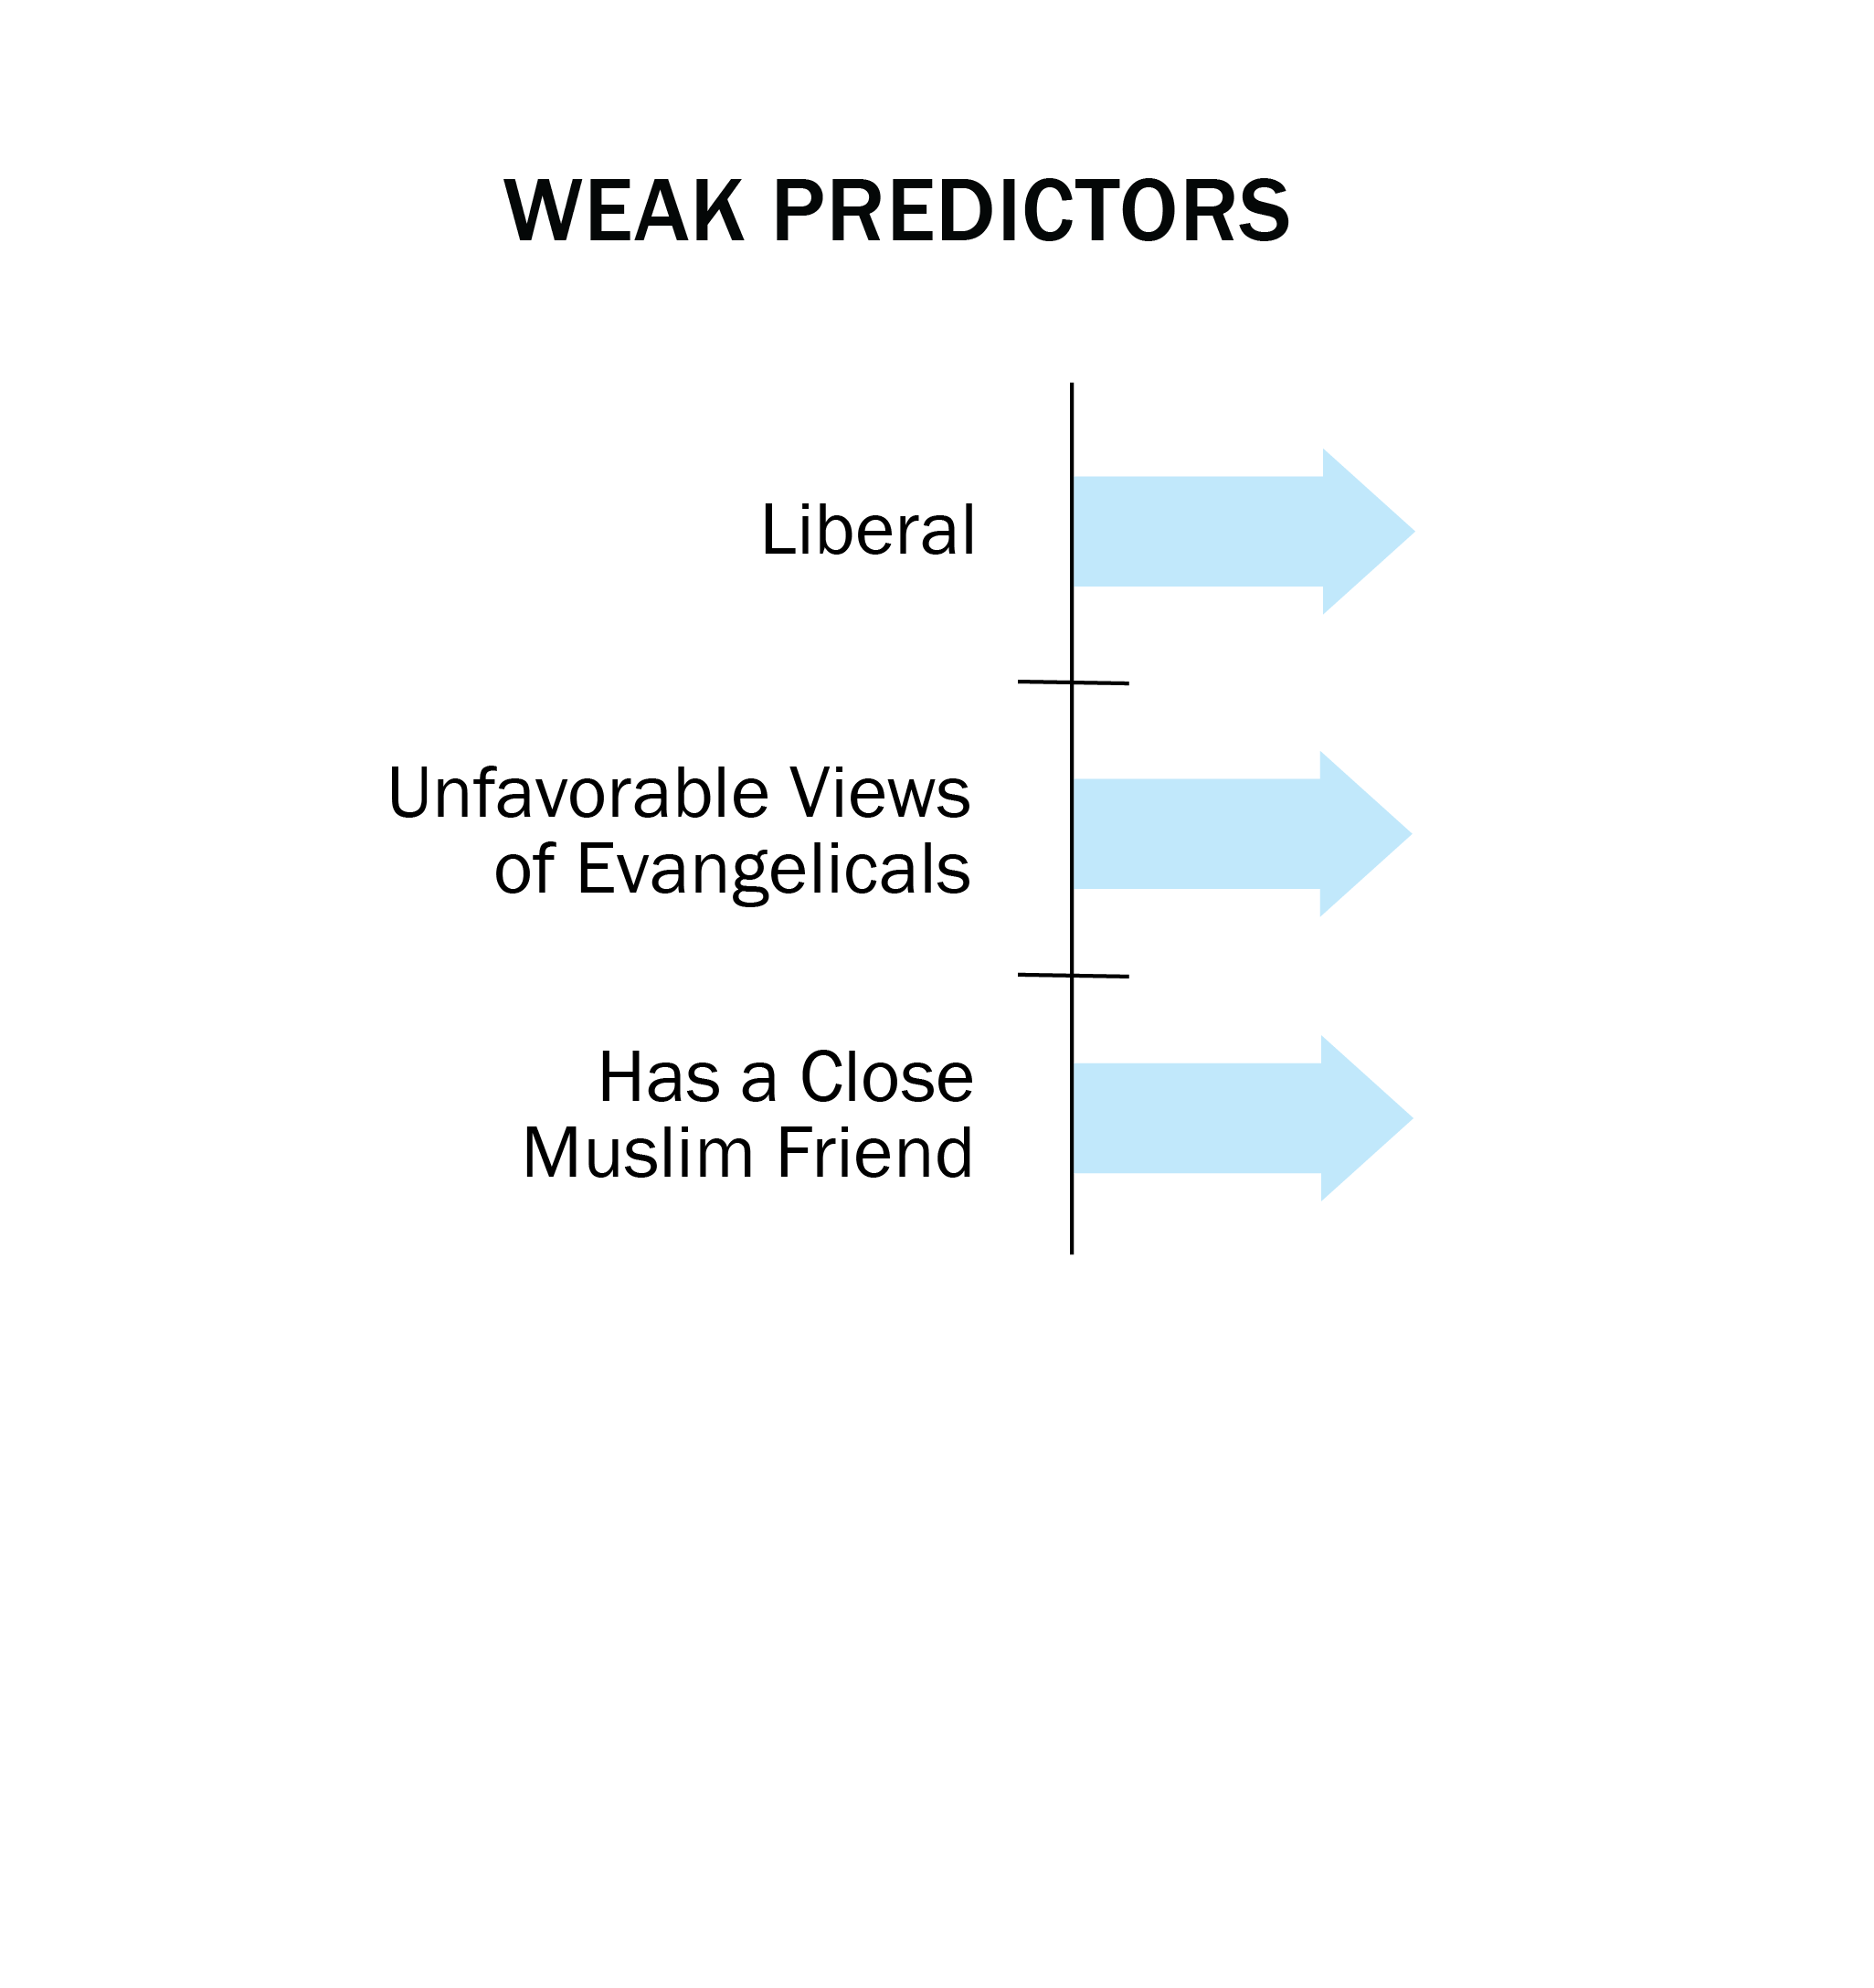
What predicts lower Islamophobia?

Slide 42
What Predicts Lower Islamophobia?

Slide 46
Age, Sex, Education, and Religiosity Make No Difference
Factors that do NOT predict Islamophobia:
Nativity
Sex
Age
Education
Religiosity

Slide 47
Faith & Community

Slide 48
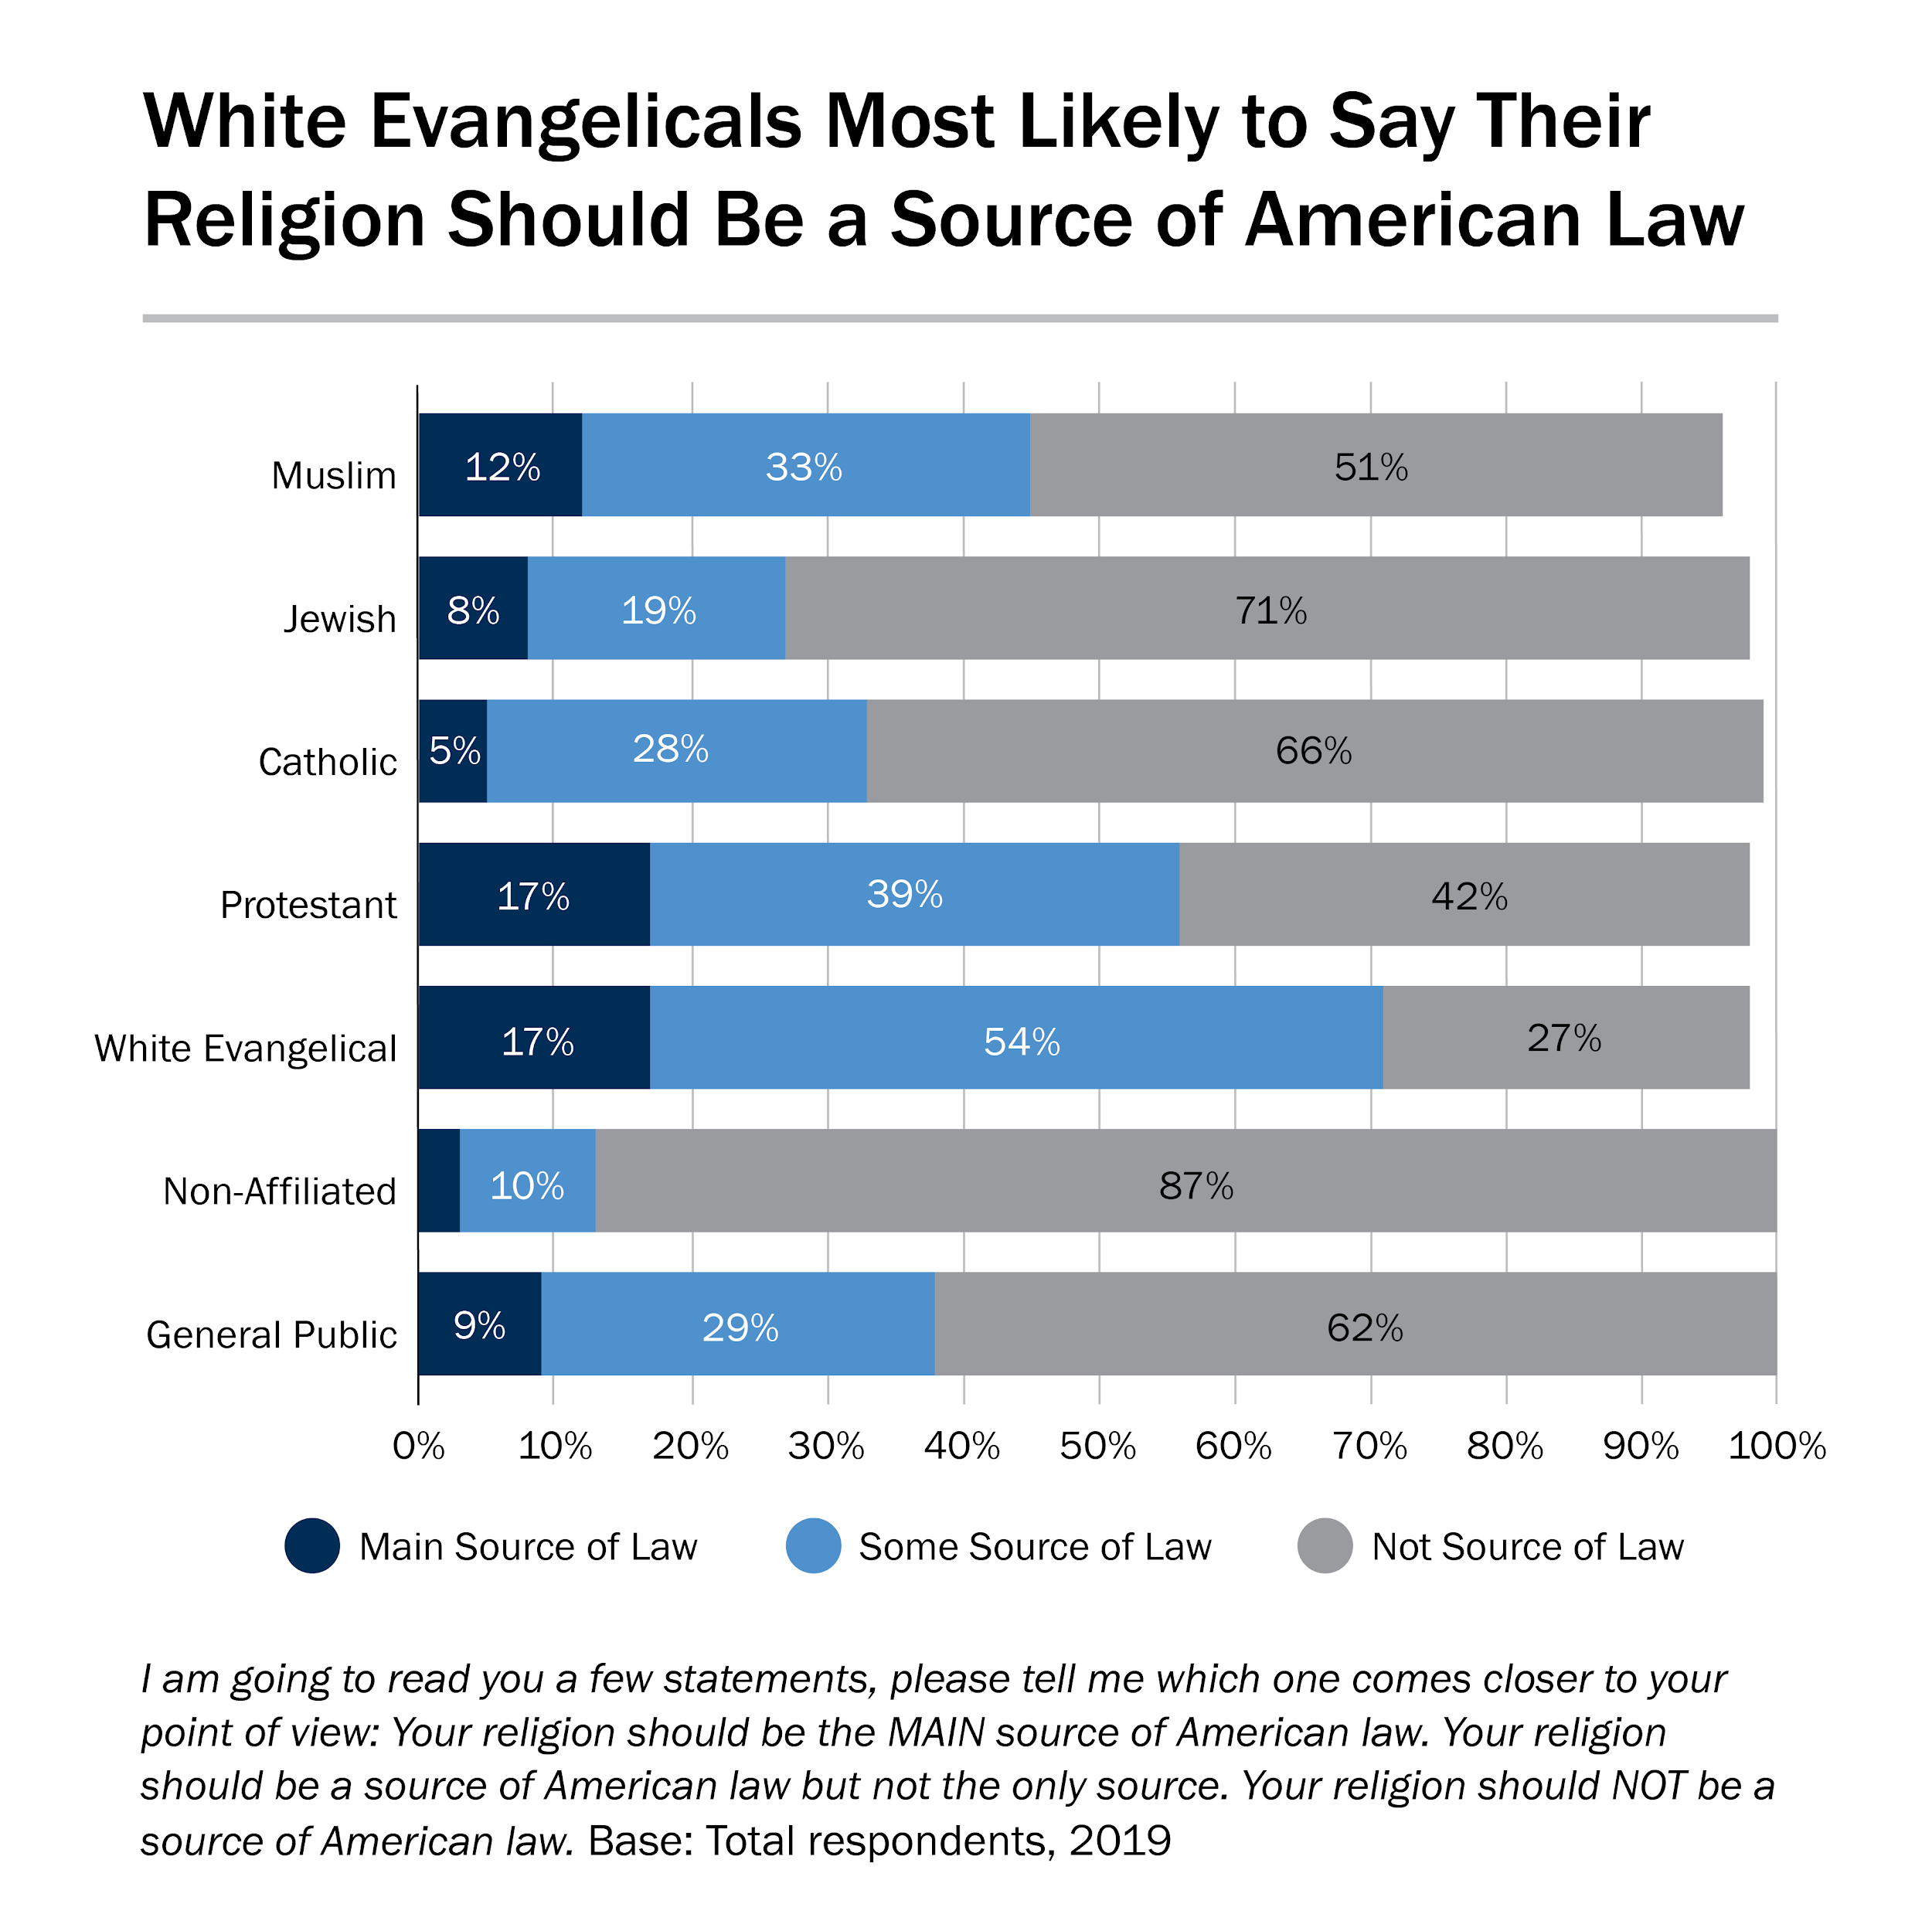

Slide 49
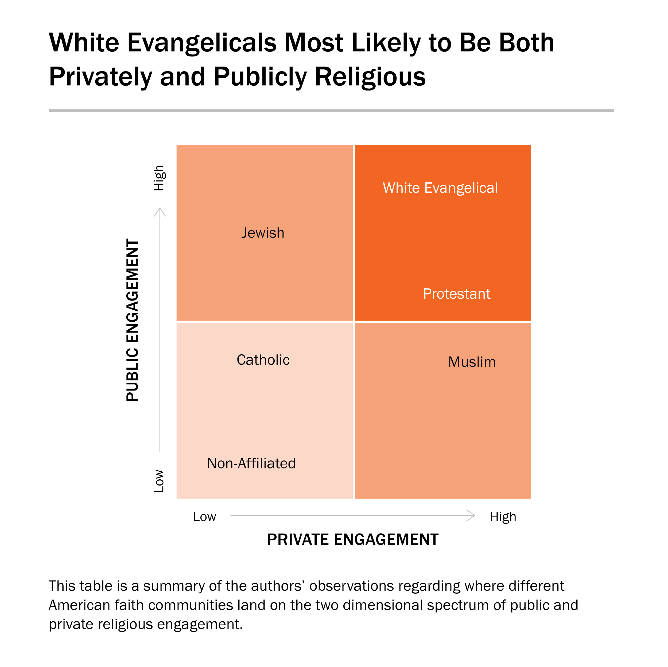

Slide 50
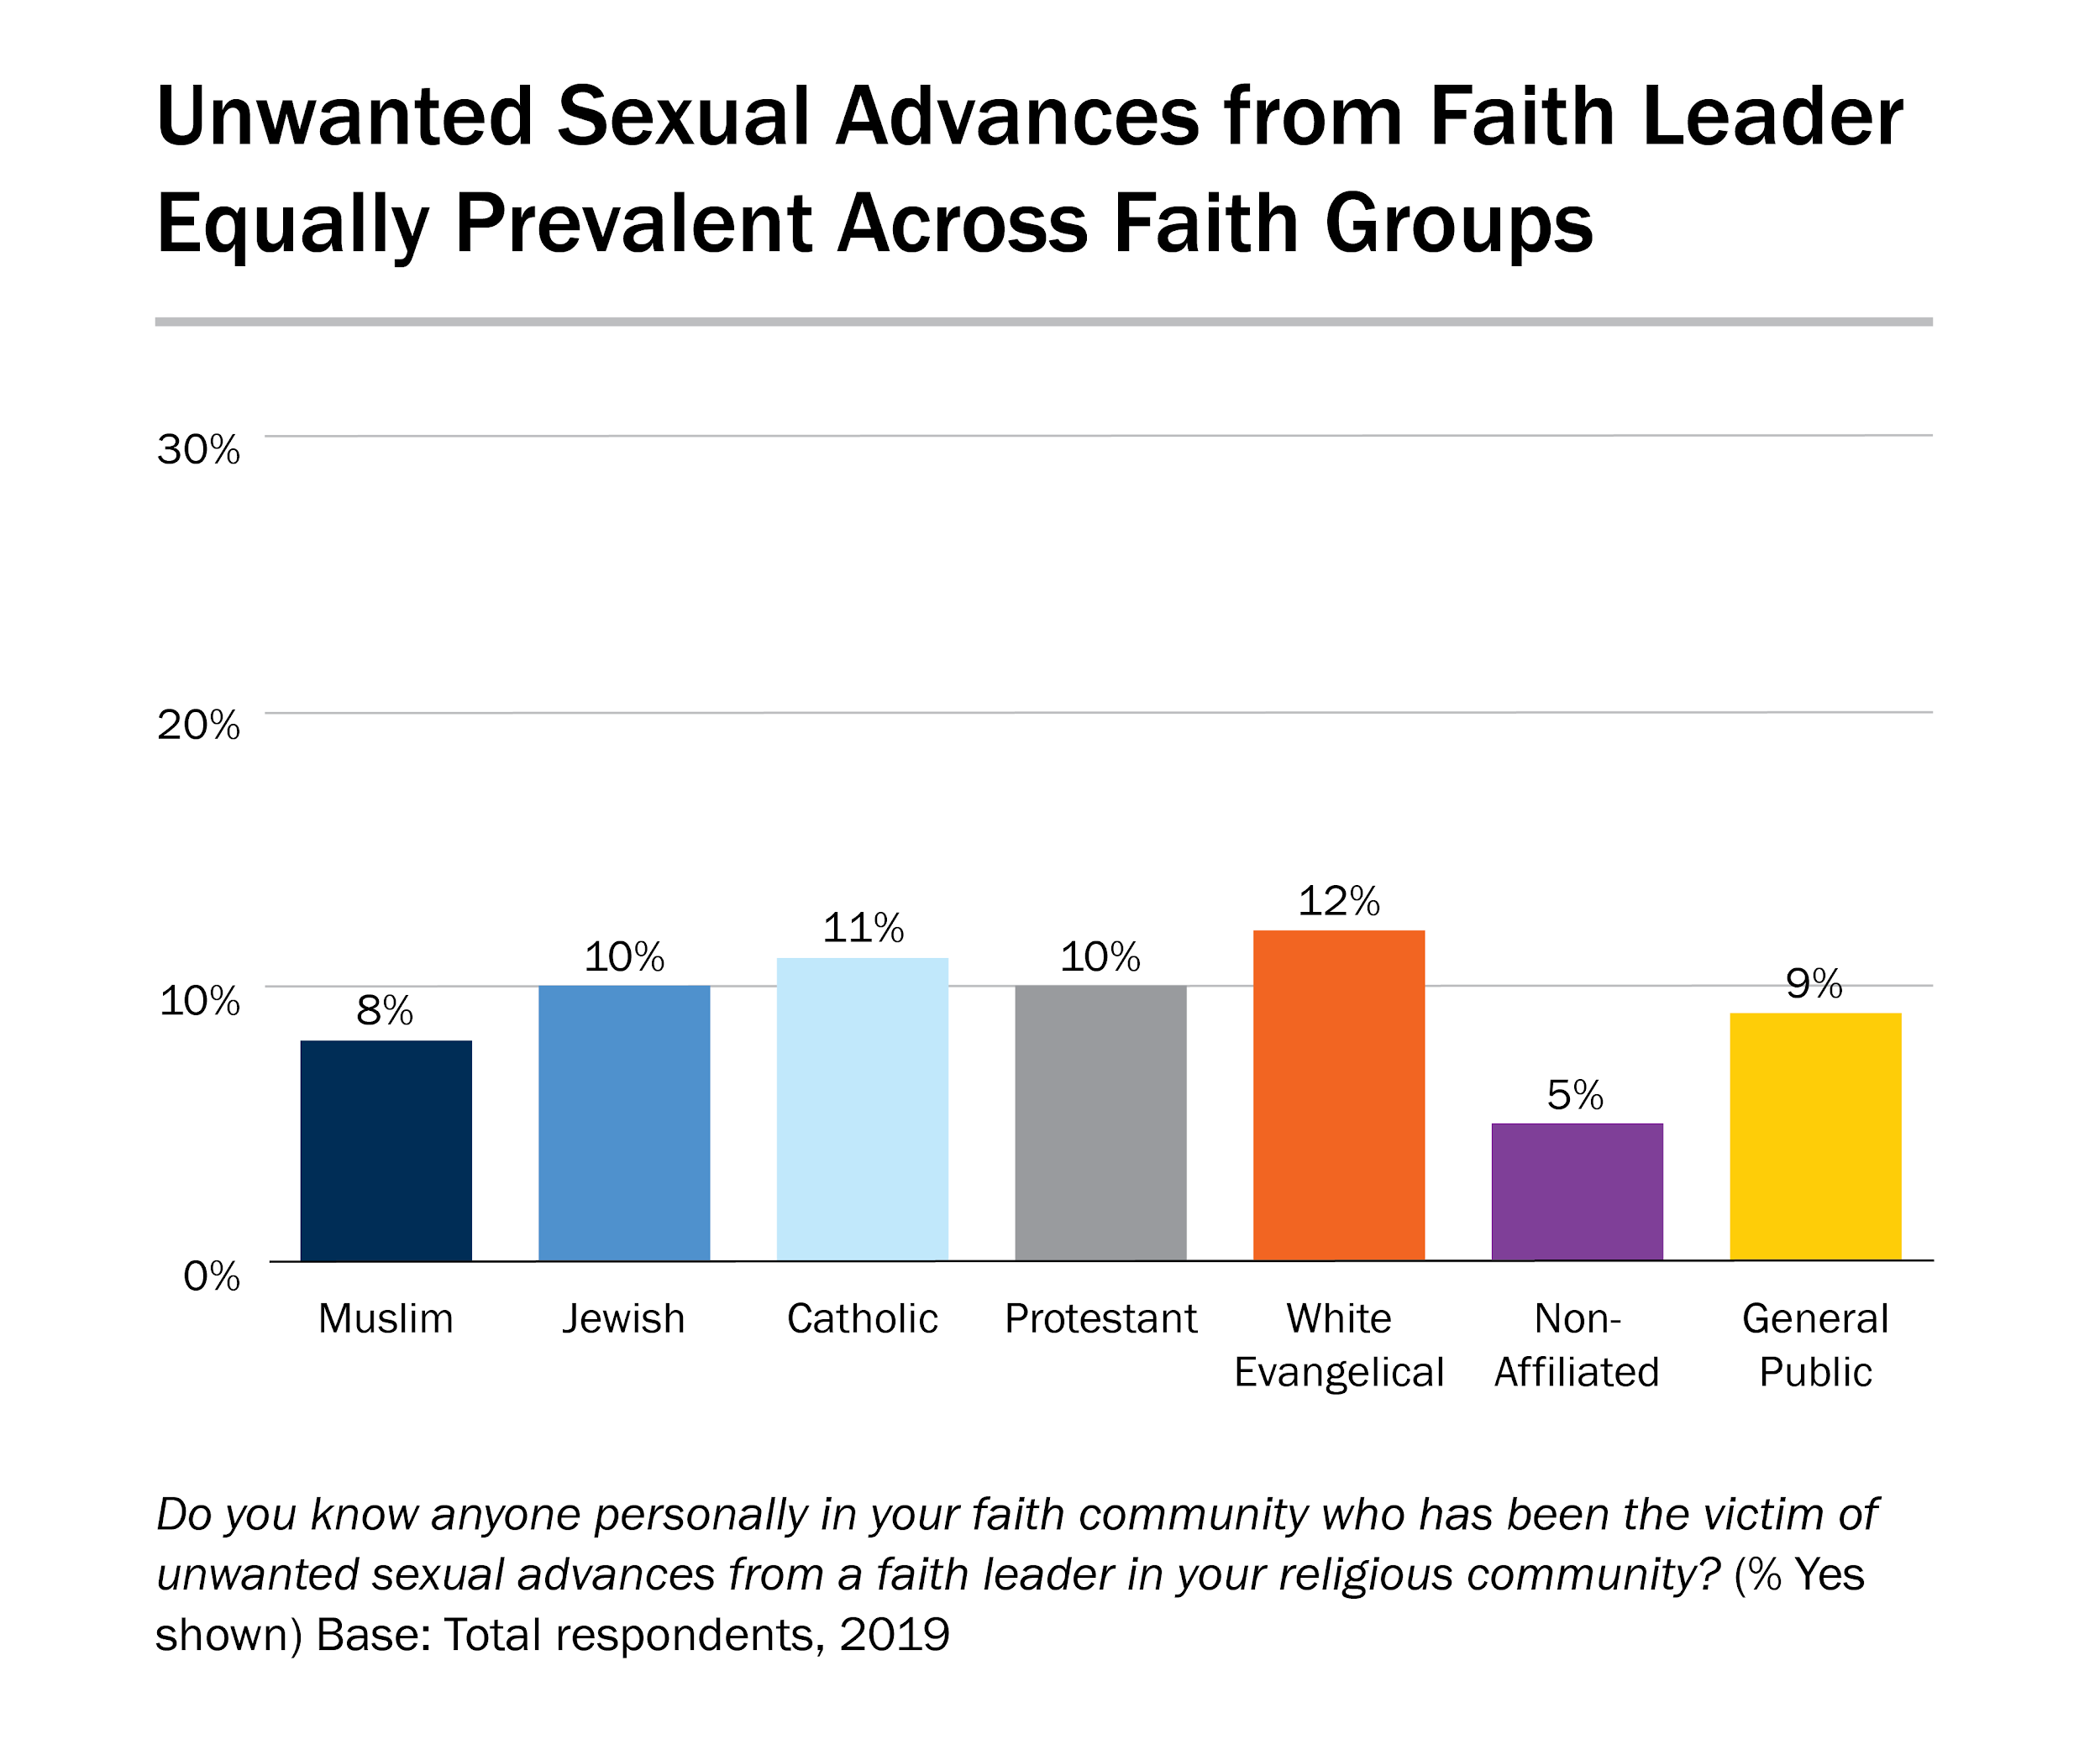

Slide 51
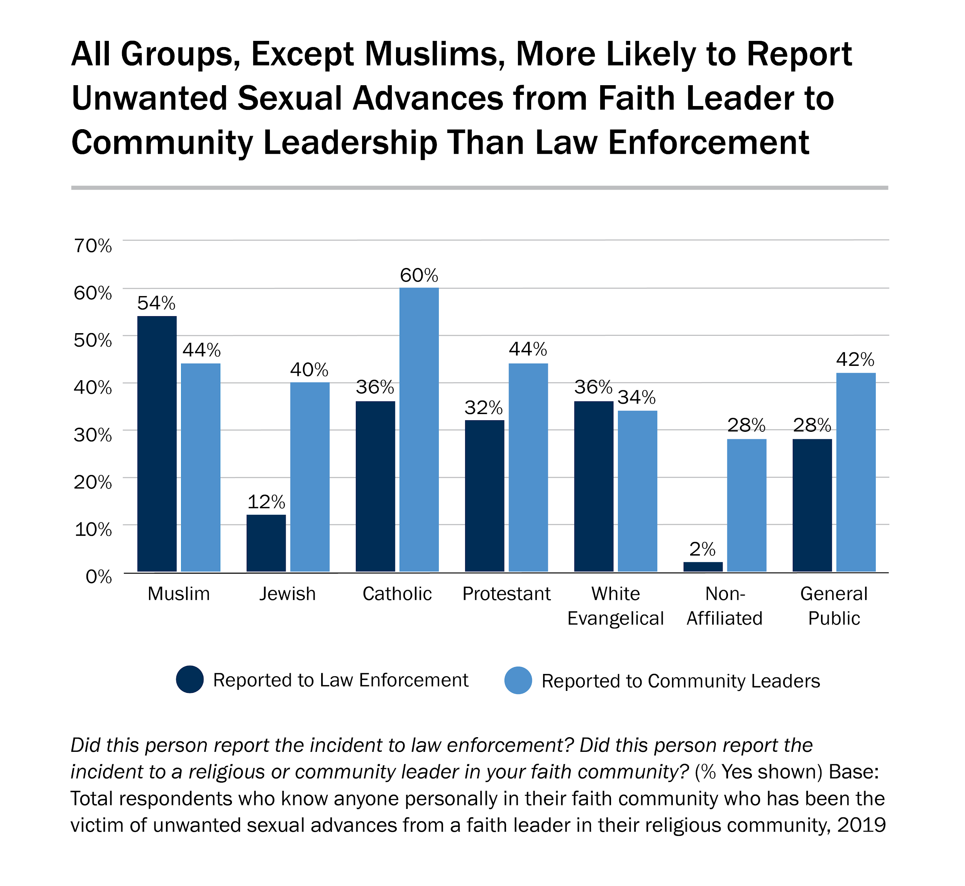

Slide 52
Recommendations

Slide 53
Recommendations for Increasing Civic Engagement
Build from the ground up
Mobilize at mosques
Build coalitions with natural allies
Focus on younger and economically disadvantaged voters

Slide 54
Recommendations for Combating Islamophobia
Build coalitions with other impacted communities
Keep demystifying Islam
Do more than “Interfaith”
Make Muslim Friends

Slide 55
Final Thoughts

Slide 56
Text MJ16 to 22333
Question 1: The research presented is of high quality.
5: Strongly agree
4:
3:
2:
1: Strongly disagree

Slide 57
Text MJ16 to 22333
Question 2: The research presented is relevant.
5: Strongly agree
4:
3:
2:
1: Strongly disagree

Slide 58
Text MJ16 to 22333
Question 3: I plan to apply the recommendations presented to my life and/or work.
5: Strongly agree
4:
3:
2:
1: Strongly disagree

